Slide 1



Noida Institute of Engineering and Technology, Greater Noida
Descriptive measures
Unit: 1
Subject Name:Statistics and Probability
Dr. Anil Agarwal
AKTU
Mathematics
B Tech 3rd Sem: AIML

Slide 2
Content
Introduction
Measures of central tendency – mean, median, mode
Measures of dispersion – mean deviation, standard deviation, quartile deviation, variance
Moment
Skewness and kurtosis
Least squares principles of curve fitting, Covariance
Correlation and Regression analysis
Correlation coefficient: Karl Pearson coefficient, rank correlation coefficient
Uni-variate and multivariate linear regression
Application of regression analysis, Logistic Regression
Time series analysis- Trend analysis (Least square method).

Slide 3
Course Objective
The objective of this course is to familiarize the engineers with concept of Statistical techniques, probability distribution, hypothesis testing and ANOVA and numerical aptitude. It aims to show case the students with standard concepts and tools from B. Tech to deal with advanced level of mathematics and applications that would be essential for their disciplines. The student will be able to understand:
The concept of Statistical techniques.
The concept of probability distribution.
The concept of hypothesis testing.
The concept of ANOVA.
The concept of numerical aptitude.

Slide 4
Course Outcome
CO 1:Understand the concept of moments, skewness, kurtosis, correlation, curve fitting and regression analysis.
CO 2:Understand the concept of Probability and Random variables.
CO 3: Remember the concept of probability to evaluate probability distributions
CO 4: Apply the concept of hypothesis testing and estimation of parameter.
CO 5: Solve the problems of Time & Work, Pipe & Cistern, Time, Speed & Distance, Boat & Stream, Sitting Arrangement , Clock & Calendar.

Slide 5
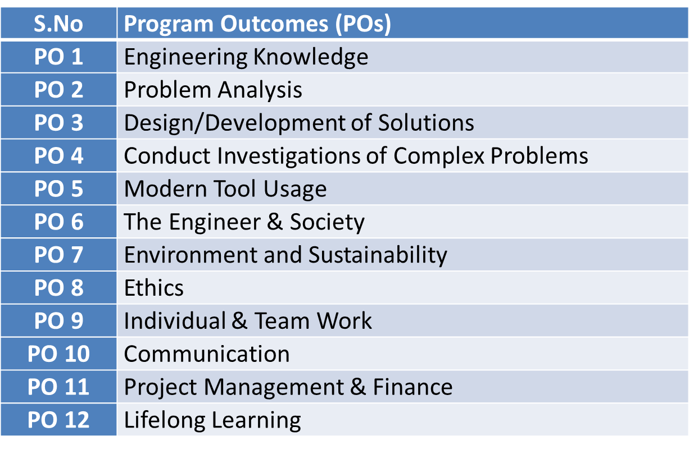
Program Outcomes

Slide 6
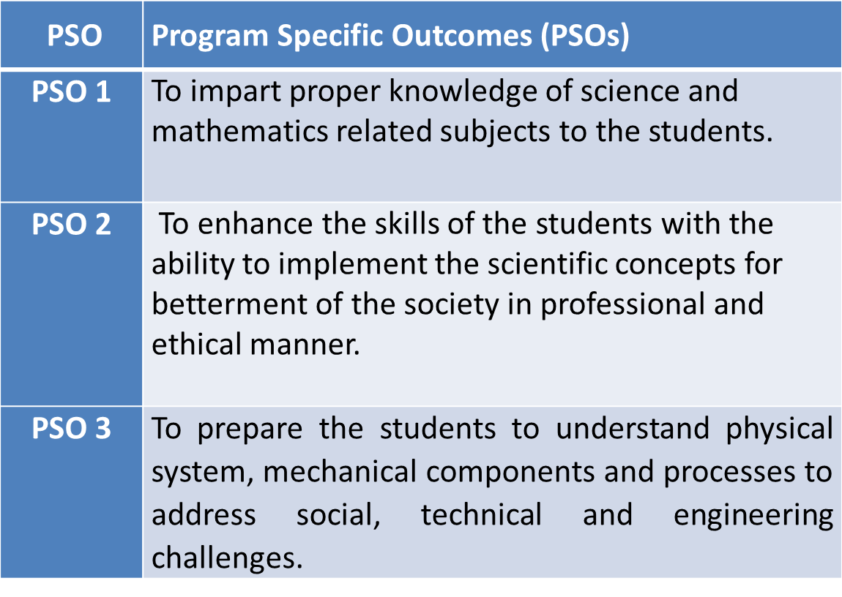
PSO

Slide 7
CO-PO Mapping(CO1)
Sr. No | Course Outcome | PO1 | PO2 | PO3 | PO4 | PO5 | PO6 | PO7 | PO8 | PO9 | PO10 | PO11 | PO12
1 | CO 1 | 3 | 3 | 3 | 3 | 1 | 1 |  |  |  |  |  | 2
2 | CO 2 | 3 | 3 | 3 | 2 | 1 | 1 |  |  |  |  | 2 | 2
3 | CO 3 | 3 | 2 | 3 | 2 |  |  |  | 1 | 1 |  |  | 1
4 | CO 4 | 3 | 2 | 2 | 3 |  | 1 | 1 |  |  |  |  | 1
5 | CO.5 | 3 | 3 | 2 | 2 | 1 |  |  |  | 1 | 1 | 2 | 2
*1= Low *2= Medium *3= High

Slide 8
CO-PSO Mapping(CO1)
*1= Low *2= Medium *3= High
CO | PSO 1 | PSO 2 | PSO 3
CO.1 | 3 | 2 | 1
CO.2 | 1 | 2 | 1
CO.3 | 2 | 2 | 2
CO.4 | 3 | 2 | 1
CO.5 | 3 | 2 | 2

Slide 9
Module Objective(CO 1)
The objective of this course is to familiarize the engineers with concept of Statistical techniques, probability distribution, hypothesis testing and ANOVA and numerical aptitude.
It aims to show case the students with standard concepts and tools from B. Tech to deal with advanced level of mathematics and applications that would be essential for their disciplines.

Slide 10
Prerequisite and Recap(CO1)
Knowledge of Maths 1 B.Tech.
Knowledge of Maths 2 B.Tech.
Knowledge of Permutation and Combination.

Slide 11
Topic objective (CO 1)
Measures of central tendency
To present a brief picture of data- It helps in giving a brief description of the main feature of the entire data.
Essential for comparison- It helps in reducing the data to a single value which is used for doing comparative studies.
Helps in decision making- Most of the companies use measuring central tendency to plan and develop their businesses economy.
Formulation of policies- Many governments rely on this medium while forming any policies.

Slide 12
Measures of Central Tendency (CO1)
Measures of Central Tendency or Averages:
Definition : According to Prof. Bowley: Averages are “statistical constants which enable us to comprehend in a single effort the significance of the whole.”
Types of Measures of Central Tendency: There are five types of measures of central tendency
Arithmetic Mean or Simple Mean
Median
Mode
Geometric Mean
Harmonic Mean

Slide 13
Measures of Central Tendency (CO1)
Requisites for an Ideal Measure of Central Tendency
According to Prof. Yule, the following are the characteristics to be satisfied by an ideal measure of central tendency
rigidly defined.
readily comprehensible and easy to calculate.
based on all the observations.
suitable for further mathematical treatment.
affected as little as possible by fluctuations of sampling.
not be affected much by extreme values (not due to Prof. Yule).

Slide 14
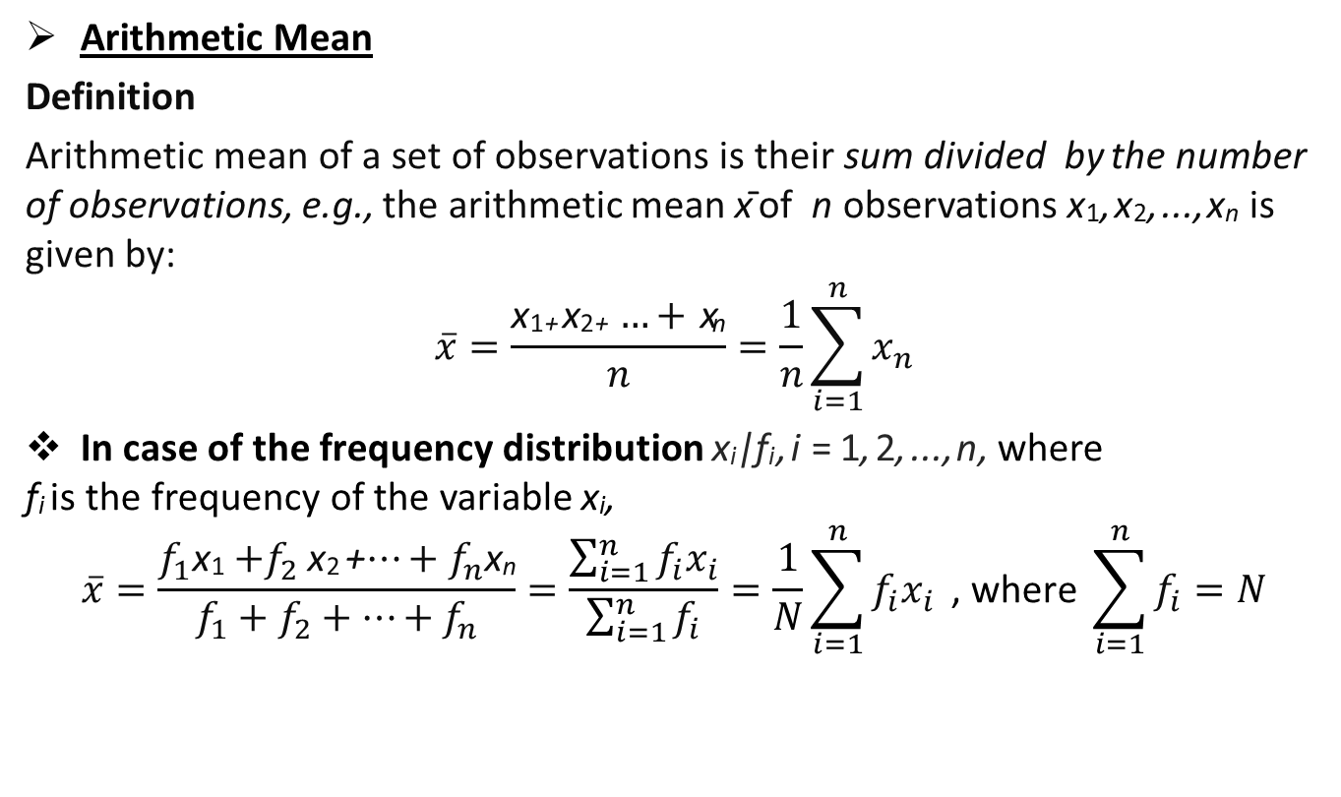
Arithmetic Mean(CO1)
ArithmeticMean
Definition
Arithmetic mean of a set of observations is their sum divided by the number of observations, e.g., the arithmetic mean x¯ of nobservations x₁,x₂,...,x_{n}is given by:
$$\overline{x}=\frac{\text{x}\text{1}\text{+} \text{x}\text{2}\text{+} …+ \text{x}\text{n}}{n}=\frac{1}{n}\sum_{i=1}^{n}{x_{n}}$$
In case of the frequencydistributionx_{i}|f_{i},i=1,2,...,n,where
f_{i} is the frequency of the variable x_{i},
$$\overline{x}=\frac{f_{1}\text{x}\text{1}{+f}_{2}\text{x}\text{2} \text{+}…+f_{n}\text{x}\text{n}}{f_{1}+f_{2}+…+f_{n}}=\frac{\sum_{i=1}^{n}{f_{i}x_{i}}}{\sum_{i=1}^{n}{f_{i}}}=\frac{1}{N}\sum_{i=1}^{n}{f_{i}x_{i}}\text{ , }\text{where} \sum_{i=1}^{n}{f_{i}}=N$$

Slide 15
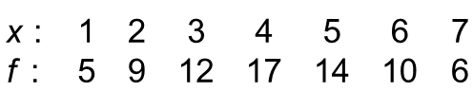
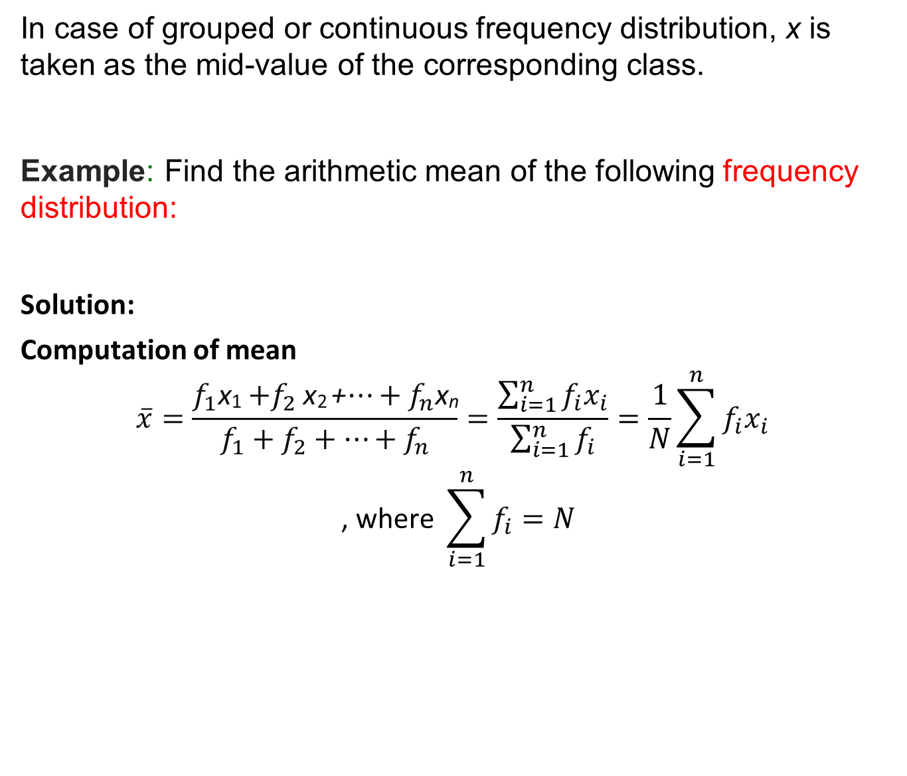
Arithmetic Mean(CO1)
In case of grouped or continuous frequency distribution, x is taken as the mid-value of the correspondingclass.
Example: Find the arithmetic mean of the followingfrequency distribution:
Solution:
Computation of mean
$$\overline{x}=\frac{f_{1}\text{x}\text{1}{+f}_{2}\text{x}\text{2} \text{+}…+f_{n}\text{x}\text{n}}{f_{1}+f_{2}+…+f_{n}}=\frac{\sum_{i=1}^{n}{f_{i}x_{i}}}{\sum_{i=1}^{n}{f_{i}}}=\frac{1}{N}\sum_{i=1}^{n}{f_{i}x_{i}}$$
$$\text{, }\text{where} \sum_{i=1}^{n}{f_{i}}=N$$

Slide 16
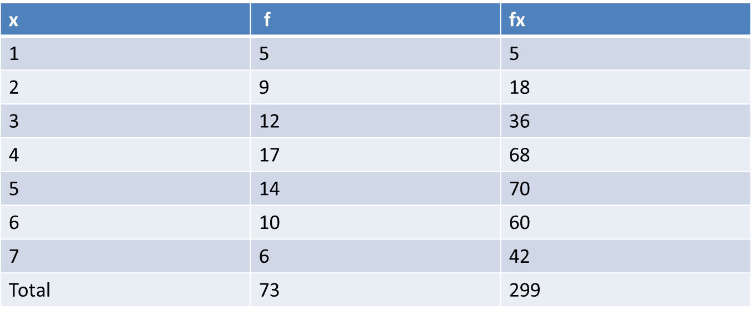
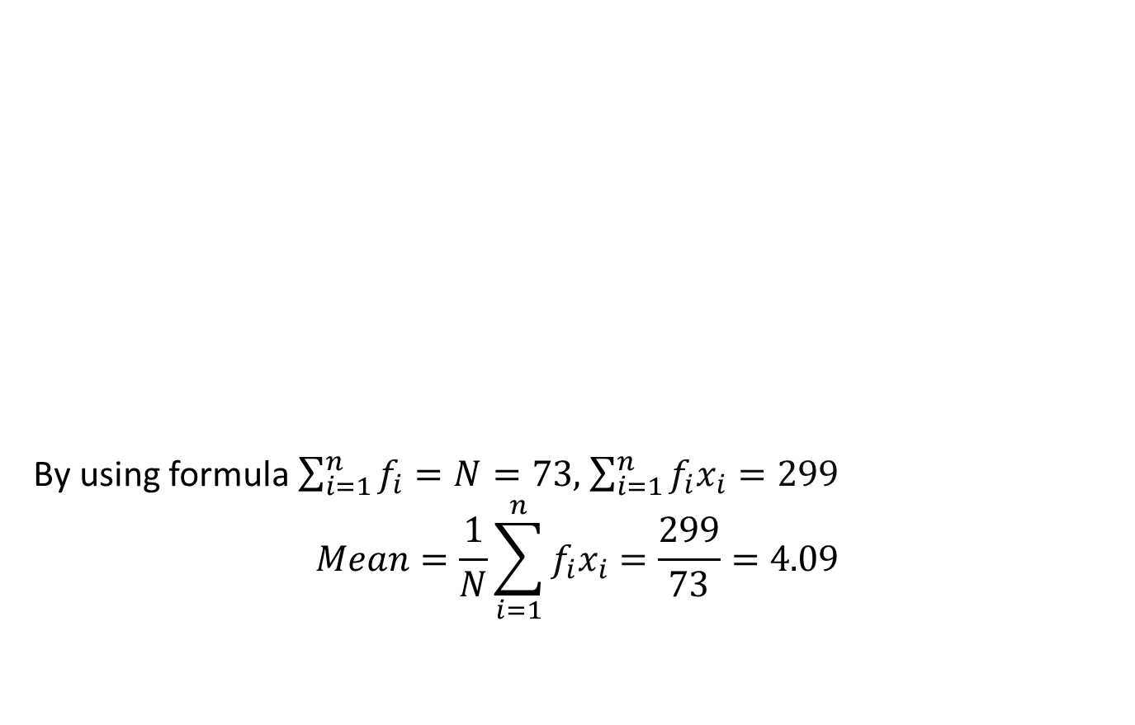
Arithmetic Mean(CO1)
By using formula$\sum_{i=1}^{n}{f_{i}}=N=73,$$\sum_{i=1}^{n}{f_{i}x_{i}}=299$
$$Mean=\frac{1}{N}\sum_{i=1}^{n}{f_{i}x_{i}}=\frac{299}{73}=\text{4}\text{.}\text{09}$$

Slide 17
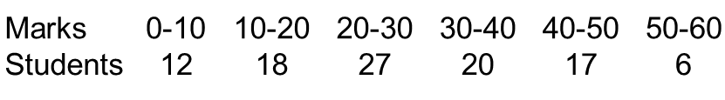
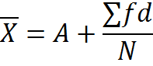
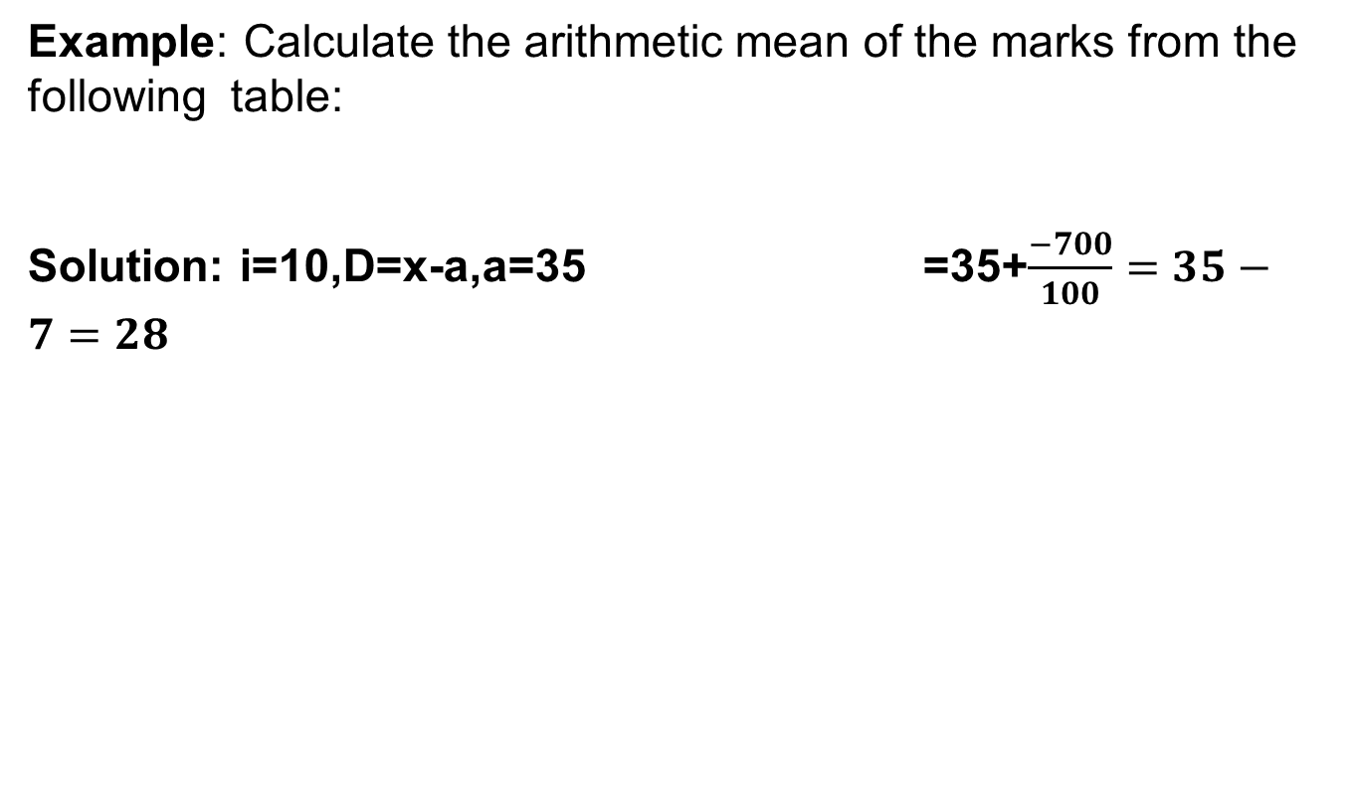
Daily Quiz (CO1)
Example:Calculate the arithmetic mean of the marks from the following table:
Solution: i=10,D=x-a,a=35 =35+$\frac{−700}{100}=35−7=28$
X | F | fx | D=x-a | Fd
5 | 12 | 60 | 5-35=-30 | -360
15 | 18 | 270 | 15-35=-20 | -360
25 | 27 | 675 | 25-35=-10 | -270
35 | 20 | 700 | 35-35=0 | 0
45 | 17 | 765 | 45-35=10 | 170
55 | 6 | 330 | 55-35=20 | 120

Slide 18
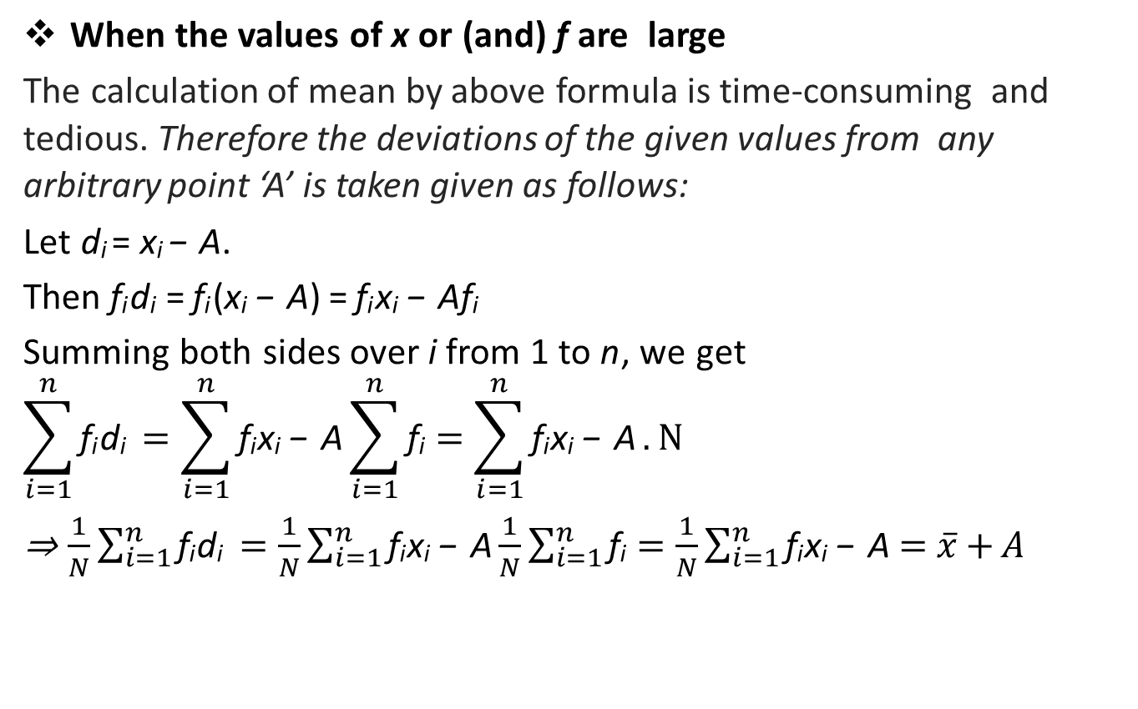
Arithmetic Mean(CO1)
Whenthe values of x or(and)f are large
The calculation of mean by above formula is time-consuming and tedious. Therefore the deviations of the given values from any arbitrary point ‘A’ is taken given as follows:
Let d_{i} = x_{i} −A.
Thenf_{i}d_{i}=f_{i}(x_{i}−A)=f_{i}x_{i}−Af_{i}
Summing both sides over i from 1 to n, weget
$$\sum_{i=1}^{n}{\text{f}\text{i} \text{d}\text{i} }=\sum_{i=1}^{n}{\text{f}\text{i} \text{x}\text{i} \text{−} \text{A}}\sum_{i=1}^{n}{\text{f}\text{i}}=\sum_{i=1}^{n}{\text{f}\text{i} \text{x}\text{i} \text{−} \text{A}}.N$$
⇒ $\frac{1}{N}\sum_{i=1}^{n}{\text{f}\text{i} \text{d}\text{i} }=\frac{1}{N}\sum_{i=1}^{n}{\text{f}\text{i} \text{x}\text{i} \text{−} \text{A}\frac{1}{N}}\sum_{i=1}^{n}{\text{f}\text{i}}=\frac{1}{N}\sum_{i=1}^{n}{\text{f}\text{i} \text{x}\text{i} \text{−} \text{A}=\overline{x}+A}$

Slide 19
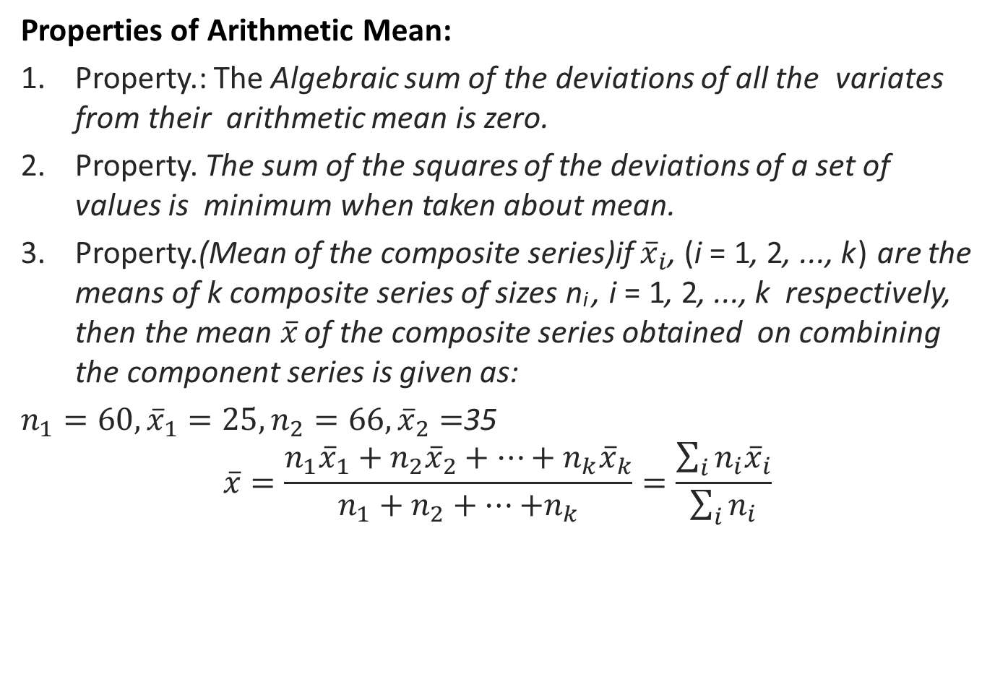
Arithmetic Mean(CO1)
Properties of ArithmeticMean:
Property.: The Algebraic sum of the deviations of all the variates from their arithmeticmeaniszero.
Property. The sum of the squares of the deviations of a set of values is minimum when taken aboutmean.
Property.(Mean of thecompositeseries)if ${\overline{x}}_{i}$, (i = 1, 2, ..., k) are the means of k composite series of sizes n_{i}, i = 1, 2, ..., k respectively, then the mean $\overline{x}$of the composite series obtained on combining the component series is givenas:
$n_{1}=60,{\overline{x}}_{1}=25,n_{2}=66,{\overline{x}}_{2}=$35
$$\overline{x}=\frac{n_{1}{\overline{x}}_{1}+n_{2}{\overline{x}}_{2}+…+n_{k}{\overline{x}}_{k}}{n_{1}+n_{2}+…{+n}_{k}}=\frac{\sum_{i}{n_{i}{\overline{x}}_{i}}}{\sum_{i}{n_{i}}}$$

Slide 20
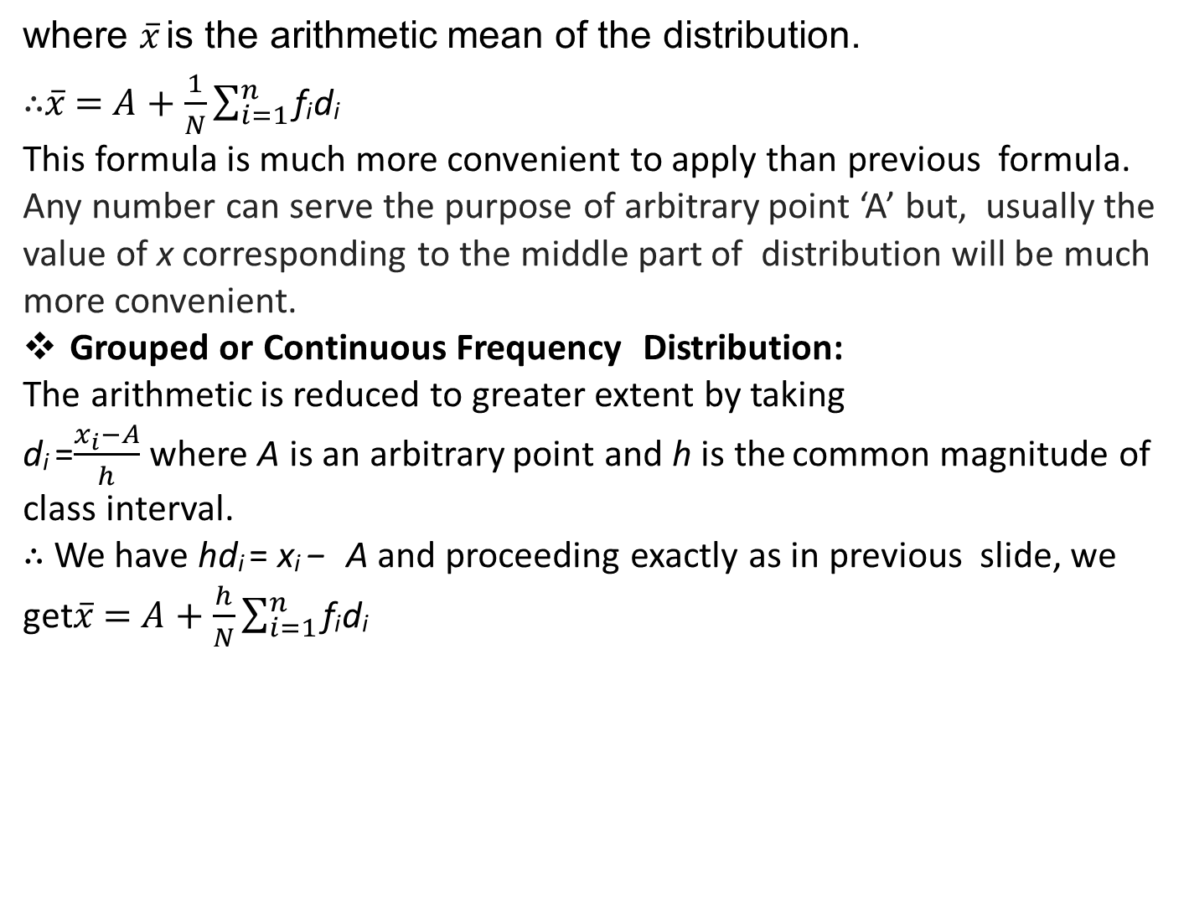
Arithmetic Mean(CO1)
where $\overline{x}$is the arithmetic mean of the distribution.
∴$\overline{x}=A+\frac{1}{N}\sum_{i=1}^{n}{\text{f}\text{i} \text{d}\text{i} }$
This formula is much more convenient to apply than previous formula.
Any number can serve the purpose of arbitrary point ‘A’ but, usually the value of x corresponding to the middle part of distribution will be much moreconvenient.
Grouped or ContinuousFrequency Distribution:
The arithmetic is reduced to greater extent bytaking
d_{i} =$\frac{x_{i}−A}{h}$where A is an arbitrary point and h is thecommon magnitude of class interval.
∴ We have hd_{i}= x_{i} − A and proceeding exactly as in previous slide, we get$\overline{x}=A+\frac{h}{N}\sum_{i=1}^{n}{\text{f}\text{i} \text{d}\text{i} }$

Slide 21
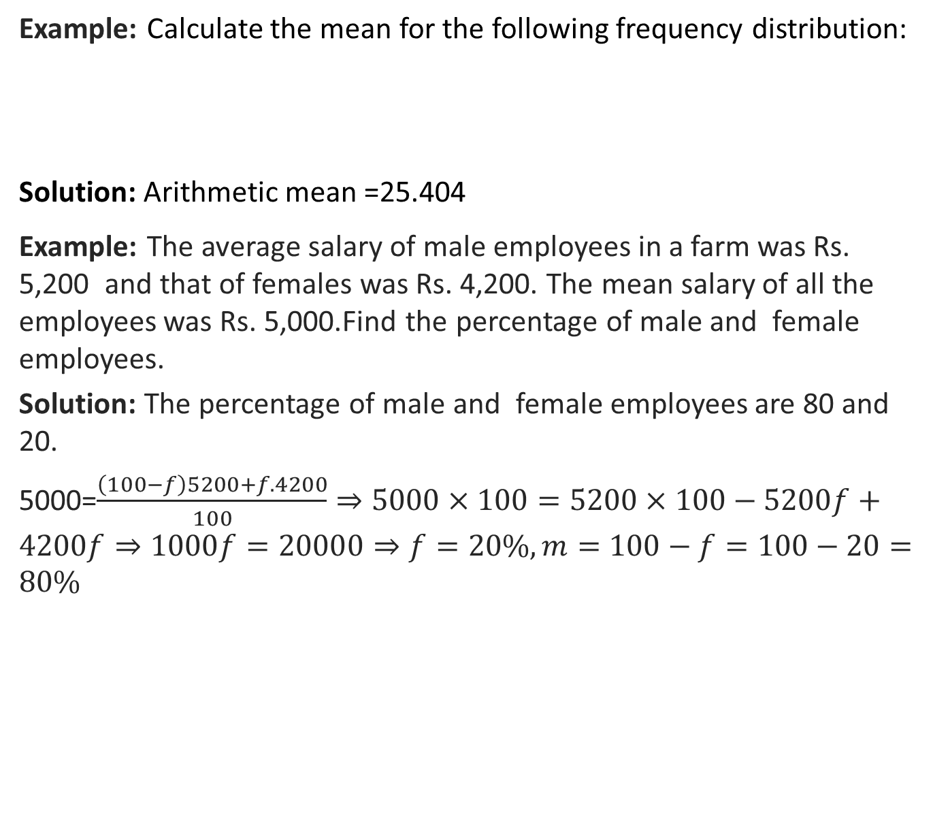
Daily Quiz(CO1)
Example:Calculate the mean for the following frequencydistribution:
Solution: Arithmetic mean =25.404
Example: The average salary of male employees in a farm was Rs. 5,200 and that of females was Rs. 4,200. The mean salary of all the employees was Rs. 5,000.Find the percentage of male and female employees.
Solution: The percentage of male and femaleemployees are 80 and 20.
5000=$\frac{\left(100−f\right)5200+f.4200}{100}⇒5000×100=5200×100−5200f+4200f⇒1000f=20000⇒f=20\%,m=100−f=100−20=80\%$
Class interval | 0-8 | 8-16 | 16-24 | 24-32 | 32-40 | 40-48
Frequency | 8 | 7 | 16 | 24 | 15 | 7

Slide 22
Median(CO1)
Median:
Definition: Median of a distribution is the value of the variable which divides it into two equal parts.
It is the value such that the number of observations above it is equal to the number of observations below it. The median is thus a positional average.
Ungrouped Data:
If the number of observations is odd then median is the middle value after the values have been arranged in ascending or descending order of magnitude.
In case of even number of observations, there are two middle terms and median is obtained by taking the arithmetic mean of middle terms.

Slide 23
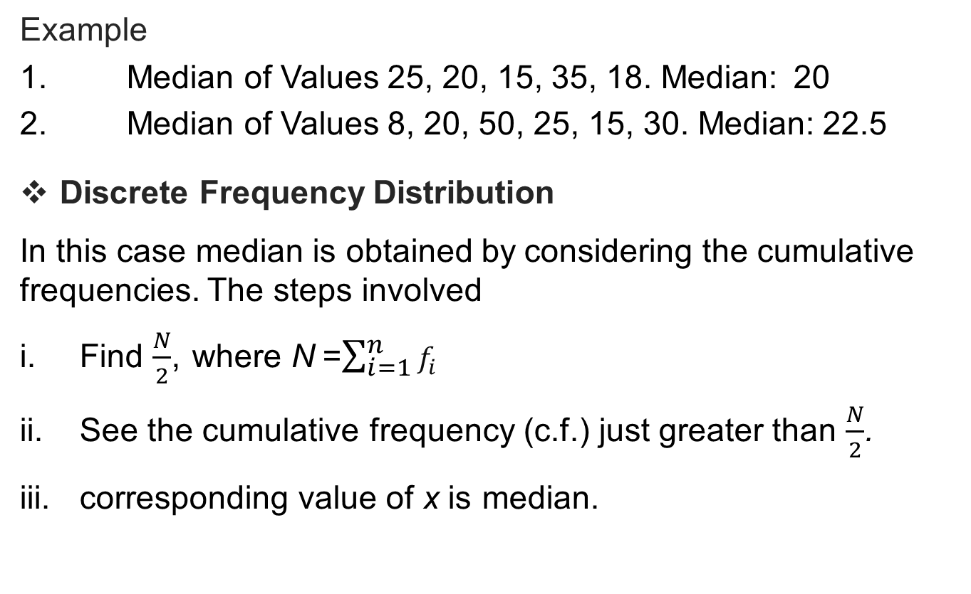
Median(CO1)
Example
1. Median of Values 25, 20, 15, 35, 18. Median:20
2. Median of Values 8, 20, 50, 25, 15, 30. Median:22.5
Discrete FrequencyDistribution
In this case median is obtained by considering thecumulativefrequencies. The steps involved
Find $\frac{N}{2}$, where N=$\sum_{i=1}^{n}{f_{i}}$
See the cumulative frequency (c.f.) just greater than $\frac{N}{2}$.
corresponding value of x ismedian.

Slide 24
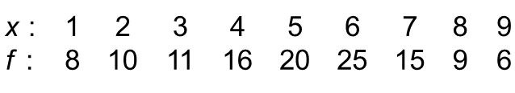
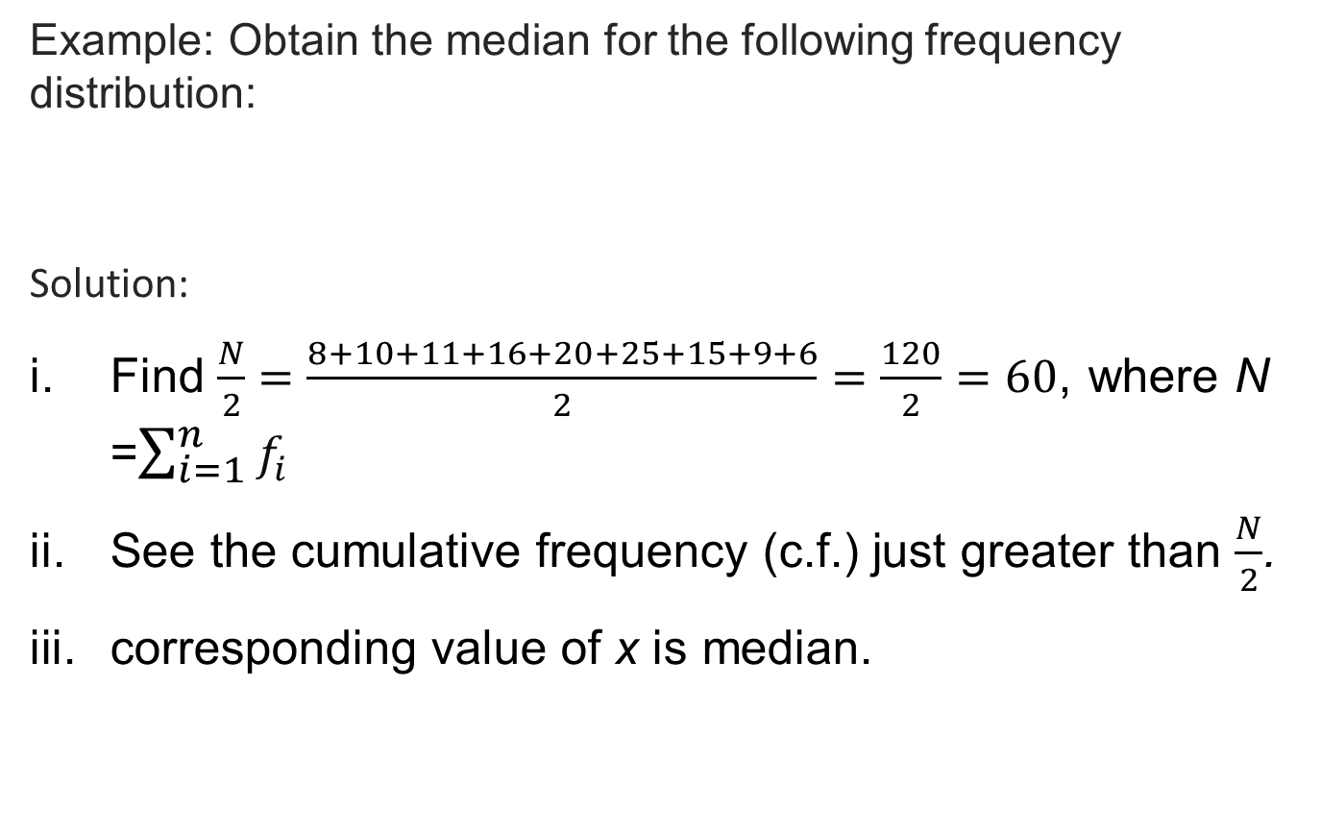
Median(CO1)
Example: Obtain the median for the following frequencydistribution:
Solution:
Find $\frac{N}{2}=\frac{8+10+11+16+20+25+15+9+6}{2}=\frac{120}{2}=60$, where N=$\sum_{i=1}^{n}{f_{i}}$
See the cumulative frequency (c.f.) just greater than $\frac{N}{2}$.
corresponding value of x ismedian.

Slide 25
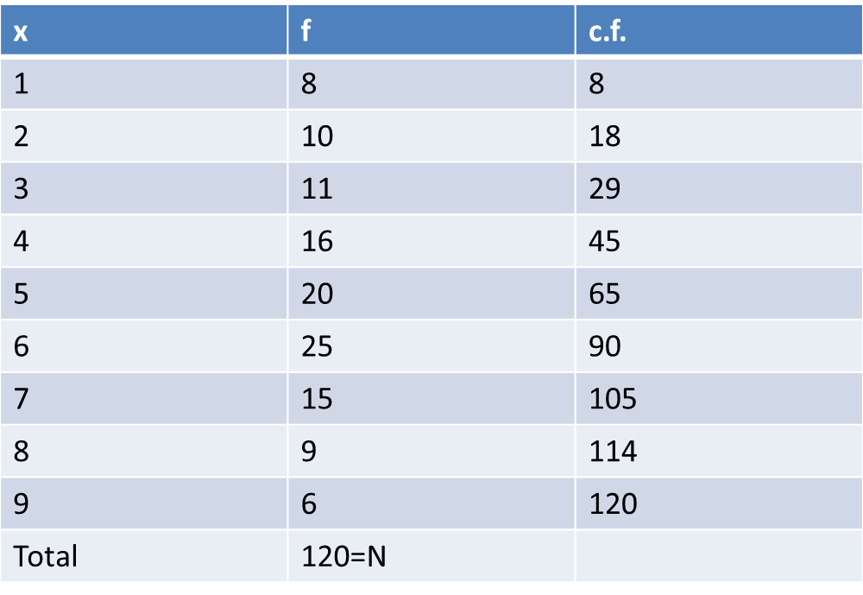
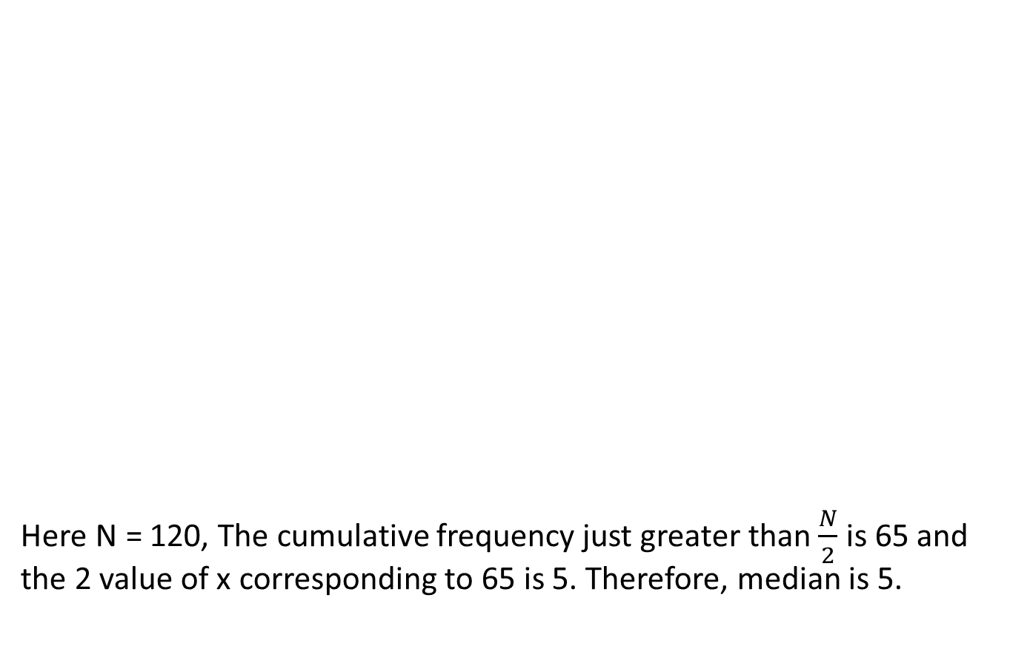
Median(CO1)
Here N =120, The cumulative frequency just greater than $\frac{N}{2}$ is 65 and the 2 value of x corresponding to 65 is 5. Therefore, median is 5.

Slide 26
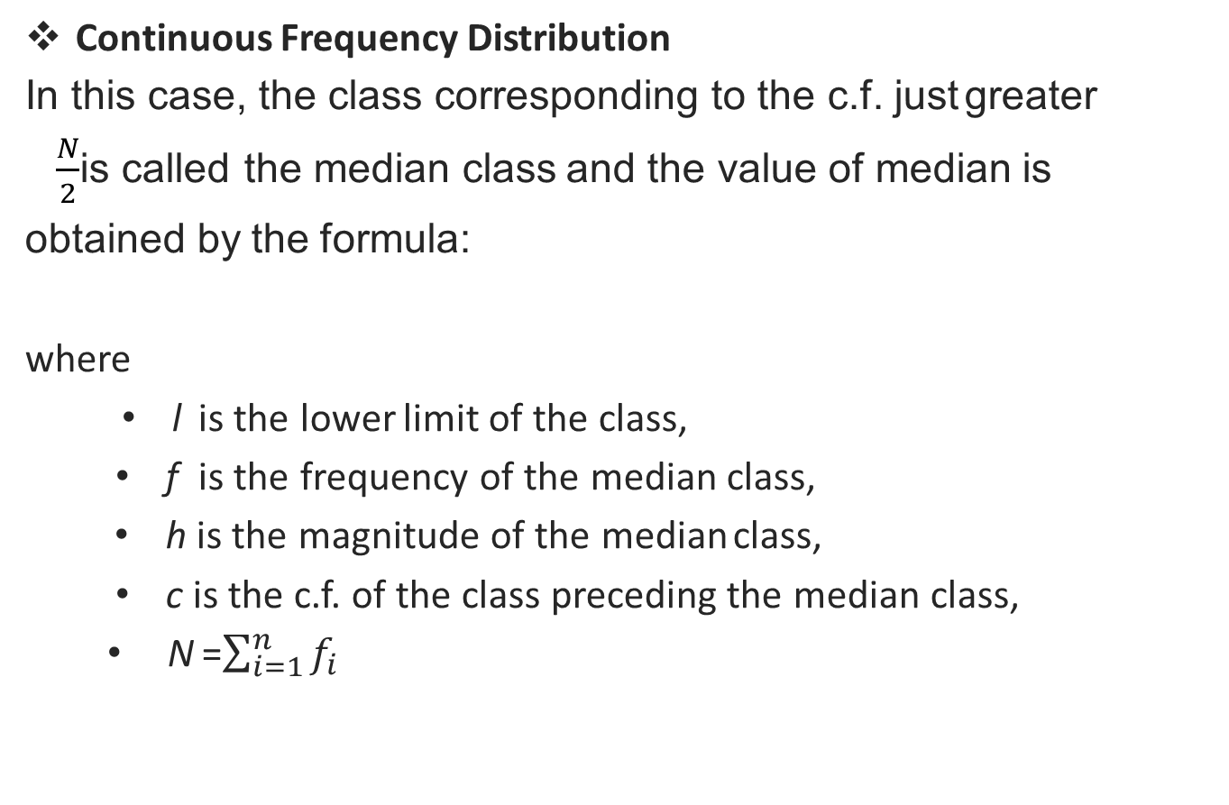

Median(CO1)
Continuous Frequency Distribution
In this case, the class corresponding to the c.f. justgreater
$\frac{N}{2}$is calledthe medianclass and the value of medianis
obtained by theformula:
where
l is the lower limit of theclass,
fis the frequency of the medianclass,
h is the magnitude of the medianclass,
c is the c.f. of the class preceding the medianclass,
N=$\sum_{i=1}^{n}{f_{i}}$
Median $=l+\frac{h}{f}\left(\frac{N}{2}−c\right)$

Slide 27
Daily Quiz(CO1)
Example : find the median wages of the following distribution.
Solution: The median wage is Rs. 4,675.
Wages | No. of workers
2000-3000 | 3
3000-4000 | 5
4000-5000 | 20
5000-6000 | 10
6000-7000 | 5

Slide 28
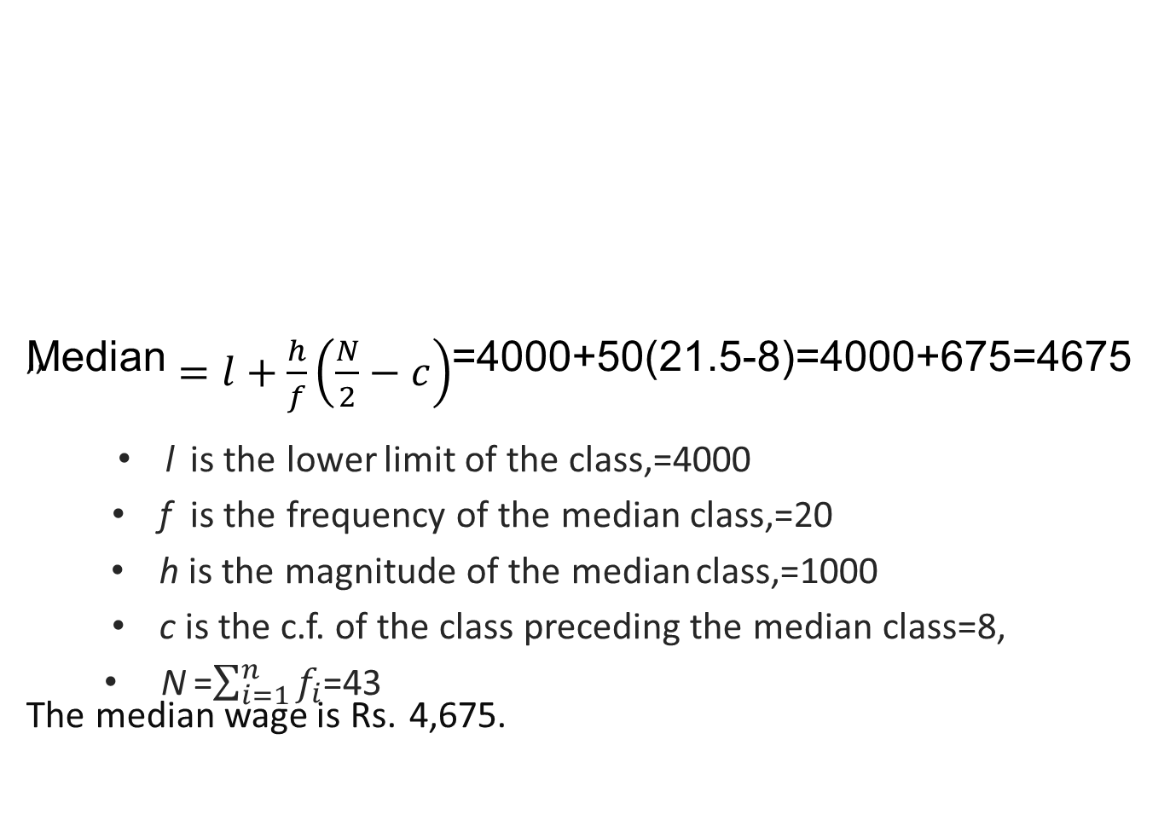
Daily Quiz(CO1)
Wages | No of workes f | C.F.
2000-3000 | 3 | 3
3000-4000 | 5 | 8
4000-5000 | 20 | 28
5000-6000 | 10 | 38
6000-7000 | 5 | 43
 | N=43
,,
Median $=l+\frac{h}{f}\left(\frac{N}{2}−c\right)$=4000+50(21.5-8)=4000+675=4675
lis the lower limit of theclass,=4000
f is the frequency of the medianclass,=20
h is the magnitude of the medianclass,=1000
c is the c.f. of the class preceding the medianclass=8,
N=$\sum_{i=1}^{n}{f_{i}}$=43
The median wage is Rs.4,675.

Slide 29
Median(CO1)
Uses:
Median is the only average to be used while dealing with qualitative data which cannot be measured quantitatively but still can be arranged in ascending or descending order of magnitude, e.g., to find the average intelligence or average honesty among a group of people.
It is to be used for determining the typical value in problems concerning wages, distribution of wealth, etc.

Slide 30
Mode(CO1)
Mode:
Mode is the value which occurs most frequently in a set of observations and around which the other items of the set cluster
densely.
It is the point of maximum frequency or the point of greatest density.
In other words the mode or modal value of the distribution is that value of the variate for which frequency is maximum.
Calculation of Mode
In case of discrete distribution: Mode is the value of x corresponding to maximum frequency but in any one (or more)of the following cases.

Slide 31
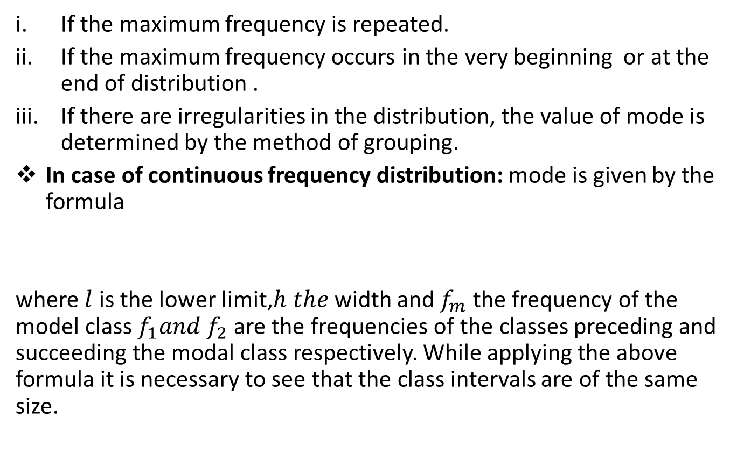

Mode(CO1)
If the maximum frequency is repeated.
If the maximum frequency occurs in the very beginning or at the end of distribution .
If there are irregularities in the distribution, the value of mode is determined by the method of grouping.
In case of continuous frequency distribution: mode is given by the formula
where $l$ is the lower limit,$h the$width and $f_{m}$ the frequency of the model class $f_{1}and f_{2}$ are the frequencies of the classes preceding and succeeding the modal class respectively. While applying the above formula it is necessary to see that the class intervals are of the same size.
Mode$=l+\frac{f_{m}−f_{1}}{2f_{m}−f_{1}−f_{2}}×h$

Slide 32
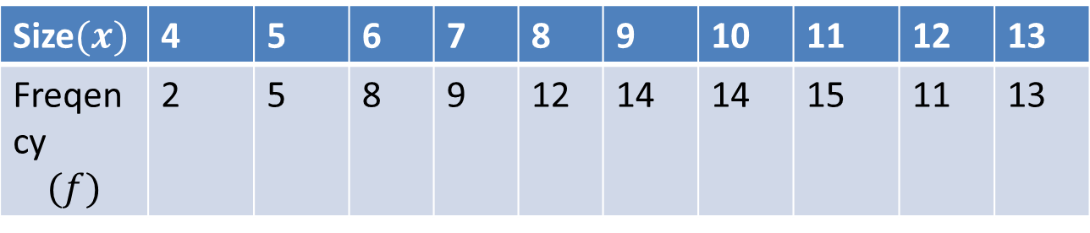
Mode(CO1)
For a symmetrical distribution, mean, median and mode coincide.
When mode is ill defined ,where the method of grouping also fails
its value can be ascertained by the formula
Mode=3Median-2Mean
This measure is called the empirical mode.
Q. Calculate the mode from the following frequency distribution.
Solution: Method of Grouping :
Size$(x)$ | 4 | 5 | 6 | 7 | 8 | 9 | 10 | 11 | 12 | 13
Freqency $$(f)$$ | 2 | 5 | 8 | 9 | 12 | 14 | 14 | 15 | 11 | 13

Slide 33
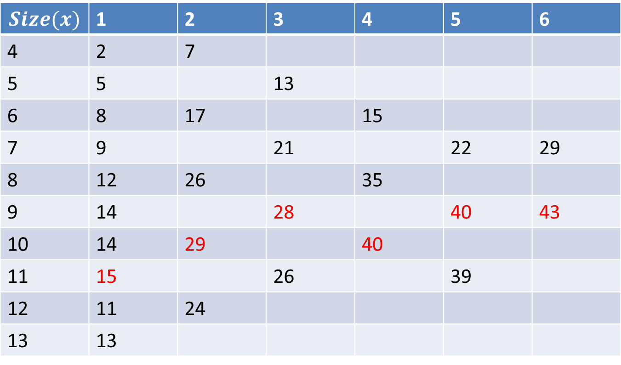
Mode(CO1)
$$Size(x)$$ | 1 | 2 | 3 | 4 | 5 | 6
4 | 2 | 7
5 | 5 |  | 13
6 | 8 | 17 |  | 15
7 | 9 |  | 21 |  | 22 | 29
8 | 12 | 26 |  | 35
9 | 14 |  | 28 |  | 40 | 43
10 | 14 | 29 |  | 40
11 | 15 |  | 26 |  | 39
12 | 11 | 24
13 | 13

Slide 34
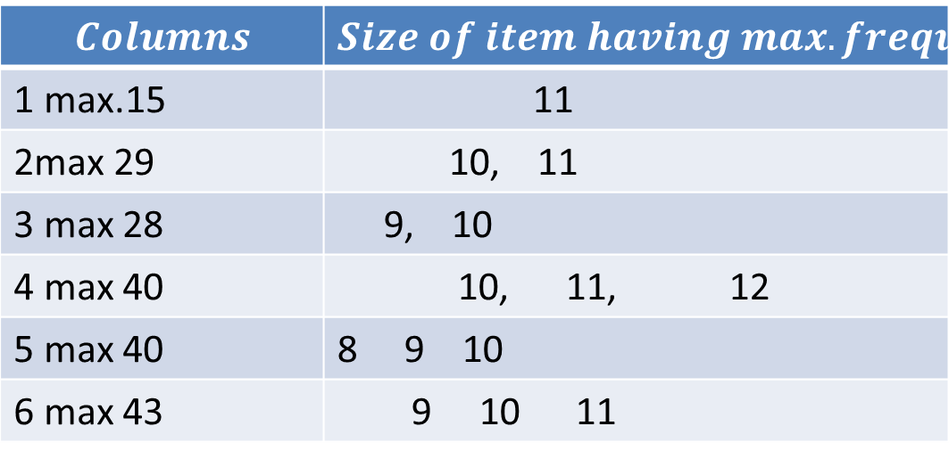
Mode(CO1)
Since the item 10 occurs maximum number of times i.e.5times,hence the mode is 10.
$$Columns$$ | $$Size of item having max.frequency$$
1 max.15 | 11
2max 29 | 10, 11
3 max 28 | 9, 10
4 max 40 | 10, 11, 12
5 max 40 | 8 9 10
6 max 43 | 9 10 11

Slide 35
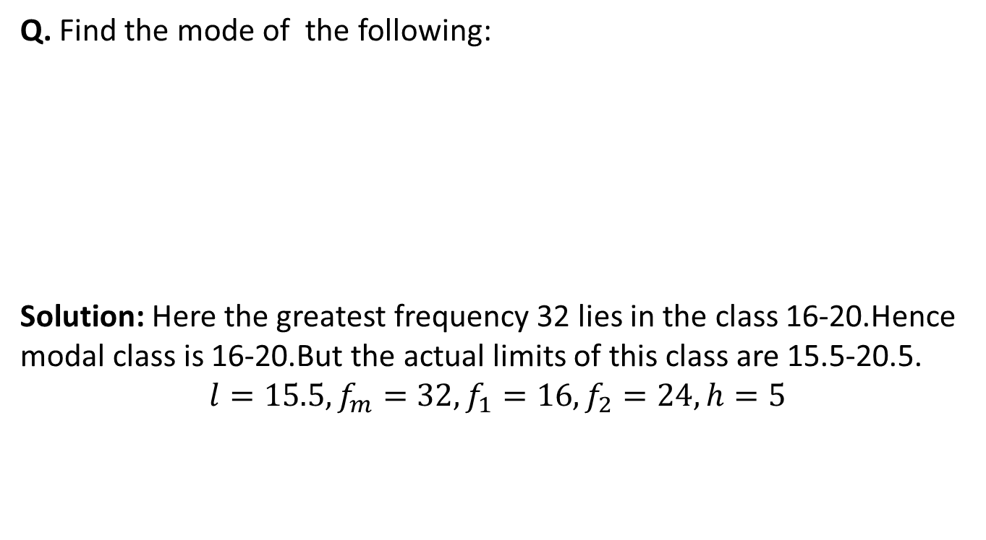
Mode(CO1)
Q. Find the mode of the following:
Solution: Here the greatest frequency 32 lies in the class 16-20.Hence modal class is 16-20.But the actual limits of this class are 15.5-20.5.
$$l=15.5,f_{m}=32,f_{1}=16,f_{2}=24,h=5$$
Marks | 0-5 | 6-10 | 11-15 | 16-20 | 21-25
No.of candidates | 7 | 10 | 16 | 32 | 24
Marks | 26-30 | 31-35 | 36-40 | 41-45
No.of candidates | 18 | 10 | 5 | 1

Slide 36
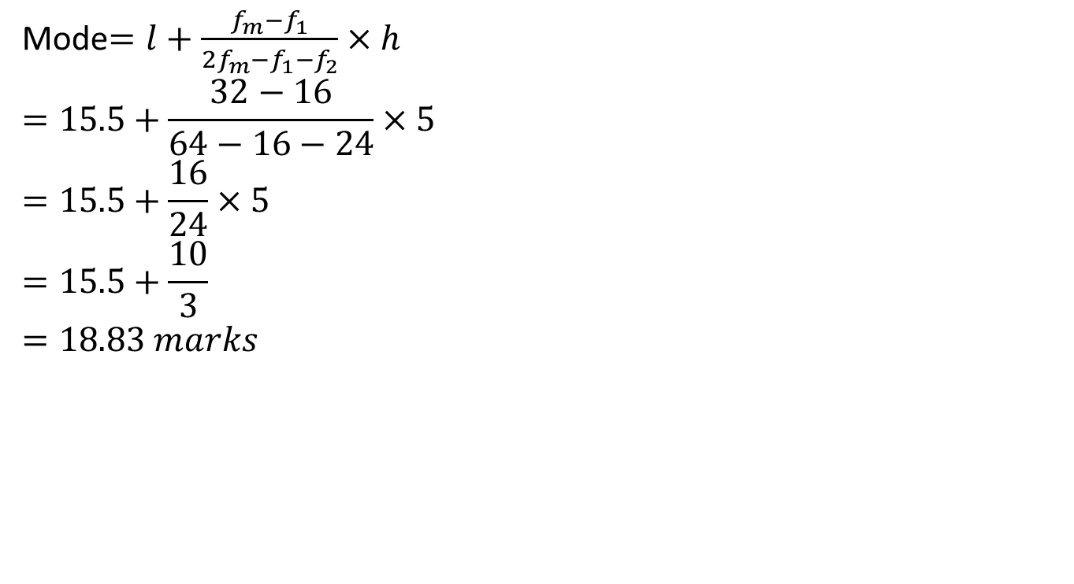
Mode(CO1)
Mode$=l+\frac{f_{m}−f_{1}}{2f_{m}−f_{1}−f_{2}}×h$
$$=15.5+\frac{32−16}{64−16−24}×5$$
$$=15.5+\frac{16}{24}×5$$
$$=15.5+\frac{10}{3}$$
$$=18.83 marks$$

Slide 37
Daily Quiz(CO3)
Q.1 Calculate the mean, median and mode of the following data-
Wages (in Rs) | 0-20 | 20-40 | 40-60 | 60-80 | 80-100 | 100-120 | 120-140
No. of Workers | 6 | 8 | 10 | 12 | 6 | 5 | 3

Slide 38
Recap(CO1)
Measures of central tendency
Mean
Mode
Median

Slide 39
OBJECTIVES OF MEASURING DISPERSION
(CO-1)
To determine the reliability of an average
To compare the variability of two or more series
For facilitating the use of other statistical measures
Basis of Statistical Quality Control

Slide 40
Definition
Measures of Dispersion(CO-1)
Measures of dispersion are descriptive statistics that describe how similar a set of scores are to each other
The more similar the scores are to each other, the lower the measure of dispersion will be
The less similar the scores are to each other, the higher the measure of dispersion will be
In general, the more spread out a distribution is, the larger the measure of dispersion will be

Slide 41
Measures of Dispersion(CO-1)
Which of the distributions of scores has the larger dispersion?
The upper distribution has more dispersion because the scores are more spread out
That is, they are less similar to each other

Slide 42
PROPERTIES OF A GOOD MEASURE OF
DISPERSION(CO-1)
Easy to understand
Simple to calculate
Uniquely defined
Based on all observations
Not affected by extreme observations
Capable of further algebraic treatment

Slide 43
MEASURES OF DISPERSION(CO-1)
Absolute Relative
Expressed in the same units in which data is expressed
In the form of ratio or percentage, so is independent of units
Ex: Rupees, Kgs,
Ltr, Km etc.
It is also called Coefficient of Dispersion

Slide 44
Measures of Dispersion(CO-1)
There are some measures of dispersion
Range
Inter quartile range
Mean deviation
Standard deviation
Variance
Coefficient of Variation

Slide 45
1.RANGE (R) (CO-1)
RANGE:-
It is the simplest measures ofdispersion
It is defined as the difference between thelargest and smallest values in theseries
R = L –S
R = Range, L = Largest Value, S = SmallestValue
Coefficient of Range$=\frac{L−S}{L+S}$

Slide 46
PRACTICE PROBLEMS – RANGE(CO-1)
Individual Series:-
Q1: Find the range &Coefficient of Range for the following data: 20, 35, 25, 30,15
Solution:-
L = Largest Value=35
S = SmallestValue=15
(Range)R = L –S=35-15=20
Coefficient of Range=$\frac{L−S}{L+S}=\frac{35−15}{35+15}=\frac{20}{50}=0.4$

Slide 47
PRACTICE PROBLEMS – RANGE(CO-1)
Discrete Frequency Distribution:
Q2: Find the range &Coefficient of
Solution:-(Range)R = L –S=70-10=60
L = Largest Value=70
S = SmallestValue=10
Coefficient of Range=$\frac{L−S}{L+S}=\frac{70−10}{70+10}=\frac{60}{80}=0.75$

Slide 48
PRACTICE PROBLEMS – RANGE(CO-1)
Continuous Frequency Distribution
Q3: Find the range &Coefficient ofRange:
Solution:-L = Upper limit of Largest class=30
S =Lower limit of SmallestValue=5
(Range)R = L –S=30-5=25
Coefficient of Range=$\frac{L−S}{L+S}=\frac{30−5}{30+5}=\frac{25}{35}=\frac{5}{7}=0.714$
Size | 5-10 | 10-15 | 15-20 | 20-25 | 25-30
F | 4 | 9 | 15 | 30 | 40

Slide 49
PRACTICE PROBLEMS – RANGE(CO-1)
Q1: Find the range & Coefficient of Range for the following data: 25, 38, 45, 30, 15
Ans:30,0.5
Q2: Find the range & Coefficient of Range:
Q3: Find the range & Coefficient of Range:

Slide 50
RANGE(CO-1)
MERITS
Simple to understand
Easy to calculate
Widely used in statistical quality control
DEMERITS
Can’t be calculated in open ended distributions
Not based on all the observations
Affected by sampling fluctuations
Affected by extreme values

Slide 51
2. INTERQUARTILE RANGE & QUARTILE DEVIATION(CO-1)
Interquartile Range is the difference between the
upper quartile (Q₃) and the lower quartile (Q₁)
It covers dispersion of middle 50% of the items of the series
Symbolically, Interquartile Range = Q₃ – Q₁
Quartile Deviation is half of the interquartile range. It is also called Semi Interquartile Range
Symbolically, Quartile Deviation = ^{𝑄3 −𝑄1}
2
Coefficient of Quartile Deviation: It is the relative measure of quartile deviation.
Coefficient of Q.D. = ^{𝑄3 −𝑄1}
𝑄₃+𝑄₁

Slide 52
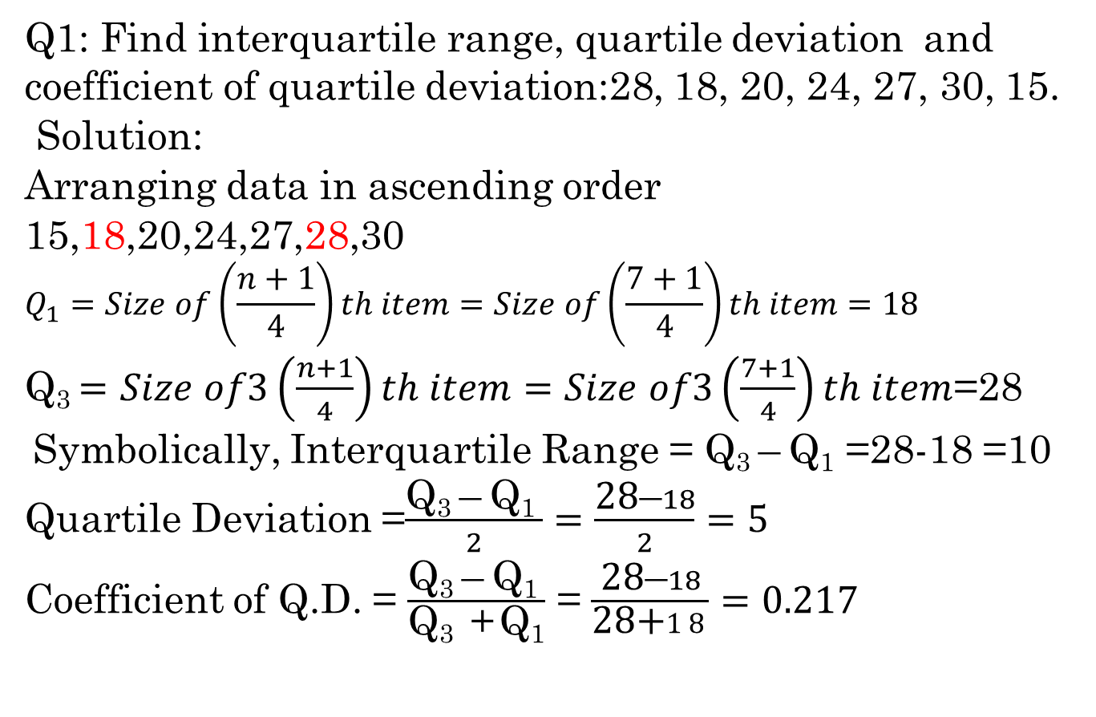
PRACTICE PROBLEMS – IQR & QD(CO-1)
Q1: Find interquartile range, quartiledeviation and coefficient of quartiledeviation:28, 18, 20, 24, 27, 30,15.
Solution:
Arranging data in ascending order
15,18,20,24,27,28,30
$$Q_{1}=Size of\left(\frac{n+1}{4}\right)th item=Size of\left(\frac{7+1}{4}\right)th item=18$$
Q₃ $=Size of3\left(\frac{n+1}{4}\right)th item=Size of3\left(\frac{7+1}{4}\right)th item$=28
Symbolically, Interquartile Range = Q₃ –Q₁=28-18=10
Quartile Deviation=$\frac{\text{Q}\text{3 }\text{–} \text{Q}\text{1 }}{2}=\frac{\text{28}\text{–}18}{2}=5$
Coefficient of Q.D. =$\frac{\text{Q}\text{3 }\text{–} \text{Q}\text{1 }}{\text{Q}\text{3 } \text{+ }\text{Q}\text{1}}$=$\frac{\text{28}\text{–}18}{\text{28}\text{+}18}=0.217$

Slide 53
PRACTICE PROBLEMS – IQR & QD(CO-1)
X | 10 | 20 | 30 | 40 | 50 | 60
F | 2 | 8 | 20 | 35 | 42 | 20
Q2
Solution:
:
X | F | C.F.
10 | 2 | 2
20 | 8 | 10
30 | 20 | 30
40 | 35 | 65
50 | 42 | 107
60 | 20 | 127
 | N=127

Slide 54
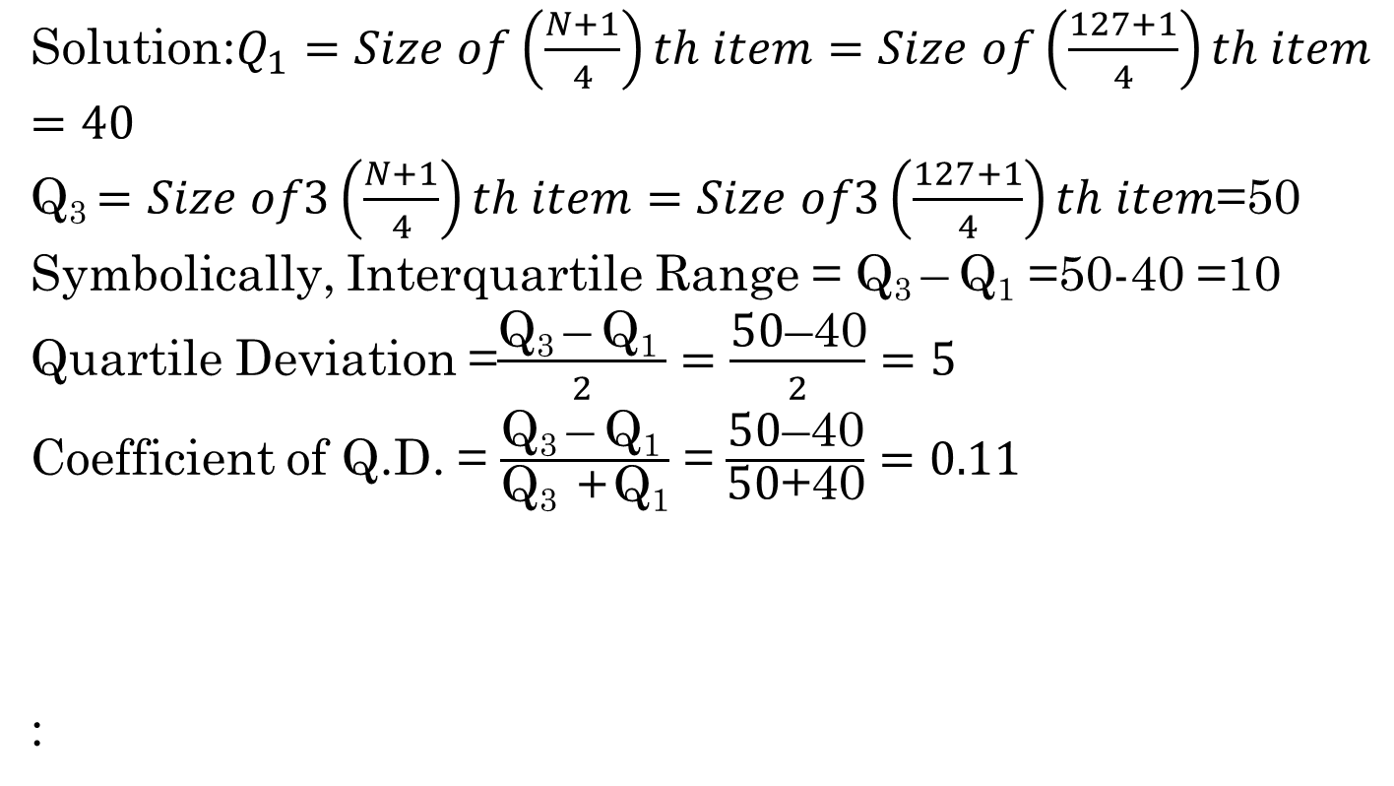
PRACTICE PROBLEMS – IQR & QD(CO-1)
Solution:$Q_{1}=Size of\left(\frac{N+1}{4}\right)th item=Size of\left(\frac{127+1}{4}\right)th item=40$
Q₃ $=Size of3\left(\frac{N+1}{4}\right)th item=Size of3\left(\frac{127+1}{4}\right)th item$=50
Symbolically, Interquartile Range = Q₃ –Q₁=50-40 =10
Quartile Deviation =$\frac{\text{Q}\text{3 }\text{–} \text{Q}\text{1 }}{2}=\frac{\text{50}\text{–}\text{40}}{2}=5$
Coefficient of Q.D. =$\frac{\text{Q}\text{3 }\text{–} \text{Q}\text{1 }}{\text{Q}\text{3 } \text{+ }\text{Q}\text{1}}$ =$\frac{\text{50}\text{–}\text{40}}{\text{50}\text{+}\text{40}}=0.11$
:

Slide 55
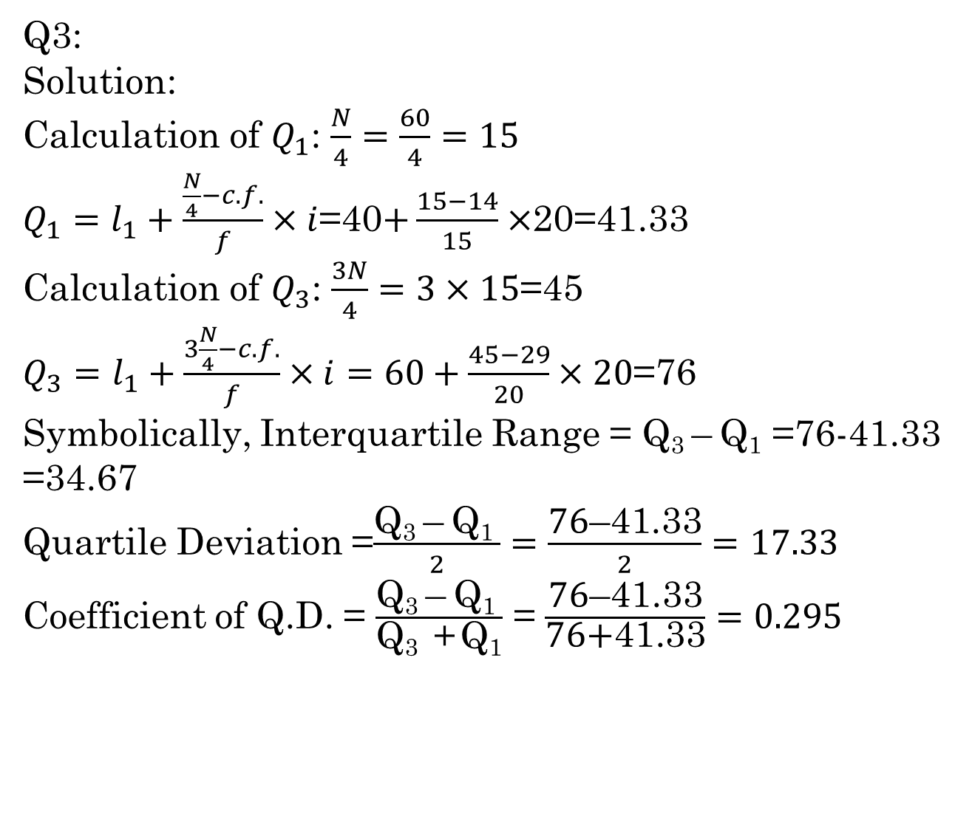
PRACTICE PROBLEMS – IQR & QD(CO-1)
Age | 0-20 | 20-40 | 40-60 | 60-80 | 80-100
Persons | 4 | 10 | 15 | 20 | 11
Q3:
Solution:
Calculation of $Q_{1}$: $\frac{N}{4}=\frac{60}{4}=15$
$Q_{1}=l_{1}+\frac{\frac{N}{4}−c.f.}{f}×i$=40$+\frac{15−14}{15}×$20=41.33
Calculation of $Q_{3}$: $\frac{3N}{4}=3×15$=45
$Q_{3}=l_{1}+\frac{3\frac{N}{4}−c.f.}{f}×i=60+\frac{45−29}{20}×20$=76
Symbolically, Interquartile Range = Q₃ –Q₁=76-41.33 =34.67
Quartile Deviation =$\frac{\text{Q}\text{3 }\text{–} \text{Q}\text{1 }}{2}=\frac{\text{76}\text{–}\text{41.33}}{2}=17.33$
Coefficient of Q.D. =$\frac{\text{Q}\text{3 }\text{–} \text{Q}\text{1 }}{\text{Q}\text{3 } \text{+ }\text{Q}\text{1}}$ =$\frac{\text{76}\text{–}\text{41.33}}{\text{76}\text{+}\text{41.33}}=0.295$

Slide 56
PRACTICE PROBLEMS – IQR & QD(CO-1)
X | F | C.F.
0-20 | 4 | 4
20-40 | 10 | 14
40-60 | 15 | 29
60-80 | 20 | 49
80-100 | 11 | 60
 | N=60

Slide 57
PRACTICE PROBLEMS – IQR & QD(CO-1)
Q1: Find quartile deviation and coefficient of quartile deviation:
4,8,10,7,15,11,18,14,12,16
Ans: 3.75, 0.32
Q2:
X | 0-10 | 10-20 | 20-30 | 30-40 | 40-50 | 60
F | 2 | 8 | 20 | 35 | 42 | 20
Ans: 10, 5, 0.11
Q3:
Age | 0-20 | 20-40 | 40-60 | 60-80 | 80-100
Persons | 4 | 10 | 15 | 20 | 11
Ans: 14.33, 0.19

Slide 58
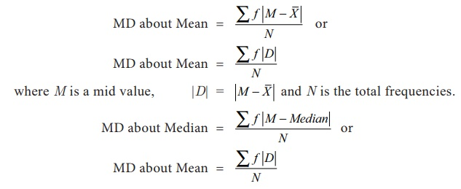
3. MEAN DEVIATION (M.D.) (CO-1)
It is also called Average Deviation
It is defined as the arithmetic average of the deviation of the various items of a series computed from measures of central tendency like mean or median.
There are some formulas to calculate mean deviation.

Slide 59
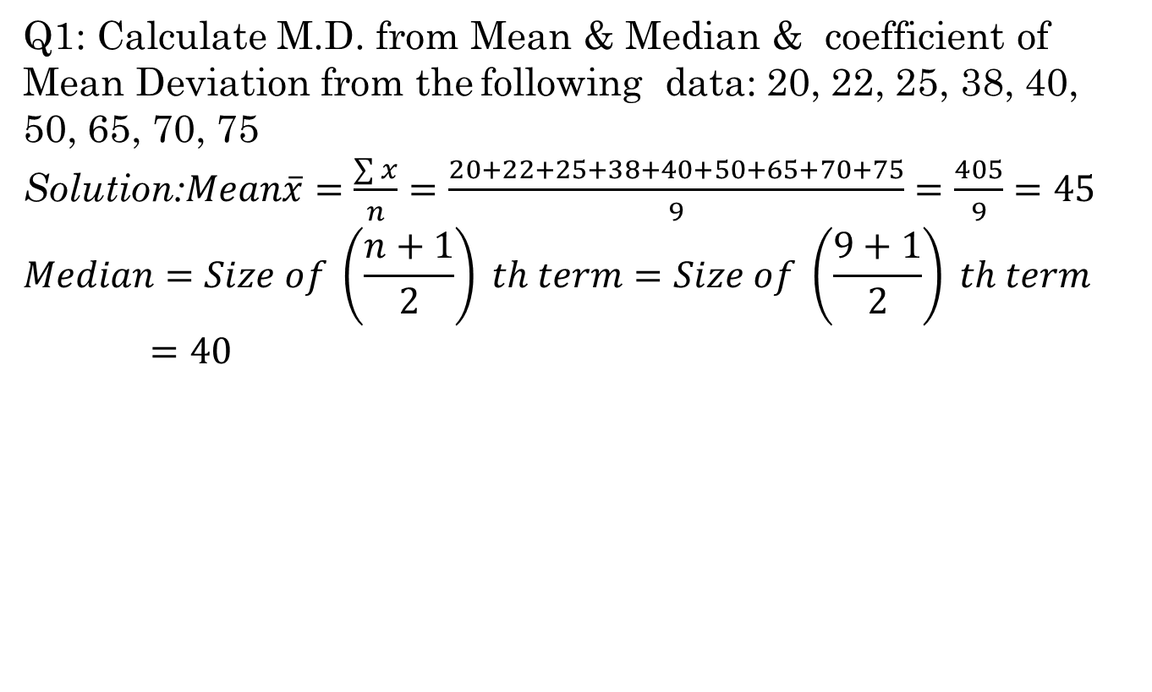
PRACTICE PROBLEMS – MEAN DEVIATION
(CO-1)
Q1: Calculate M.D. from Mean & Median & coefficient of Mean Deviation from thefollowing data: 20, 22, 25, 38, 40, 50, 65, 70,75
Solution:$Mean\overline{x}=\frac{\sum{x}}{n}=\frac{20+22+25+38+40+50+65+70+75}{9}=\frac{405}{9}=45$
$$Median=Size of \left(\frac{n+1}{2}\right) th term=Size of \left(\frac{9+1}{2}\right) th term=40$$

Slide 60
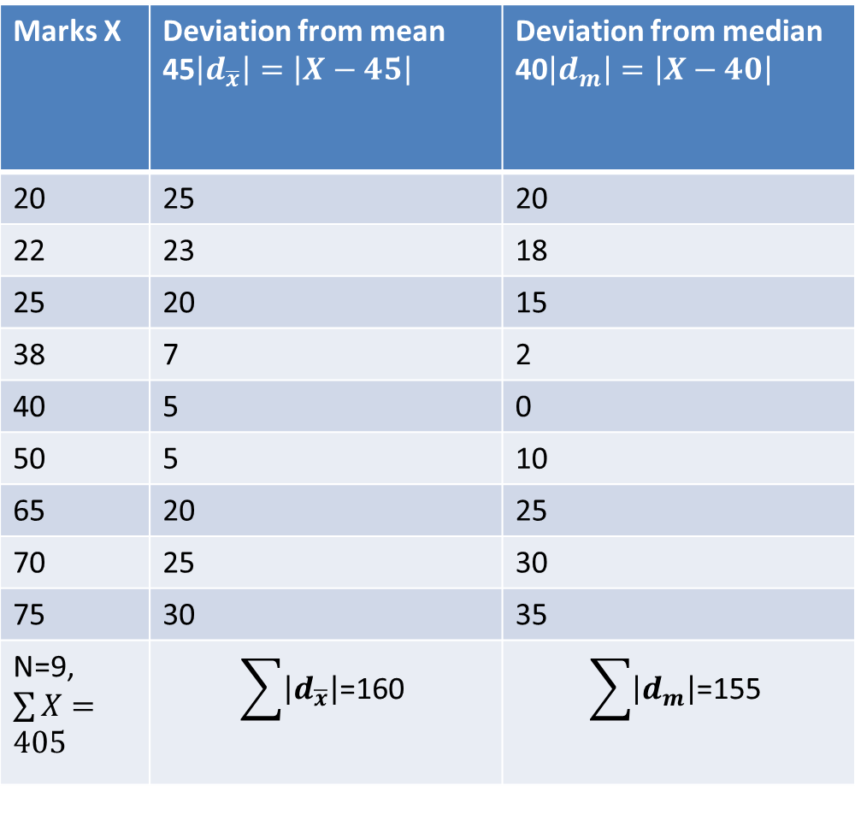
PRACTICE PROBLEMS – MEAN DEVIATION
(CO-1)
Marks X | Deviation from mean 45$\left|d_{\overline{x}}\right|=\left|X−45\right|$ | Deviation from median 40$\left|d_{m}\right|=\left|X−40\right|$
20 | 25 | 20
22 | 23 | 18
25 | 20 | 15
38 | 7 | 2
40 | 5 | 0
50 | 5 | 10
65 | 20 | 25
70 | 25 | 30
75 | 30 | 35
N=9,$\sum{X}=405$ | $$\sum{\left|d_{\overline{x}}\right|\text{=}\text{160 }}$$ | $$\sum{\left|d_{m}\right|\text{=}\text{155} }$$

Slide 61
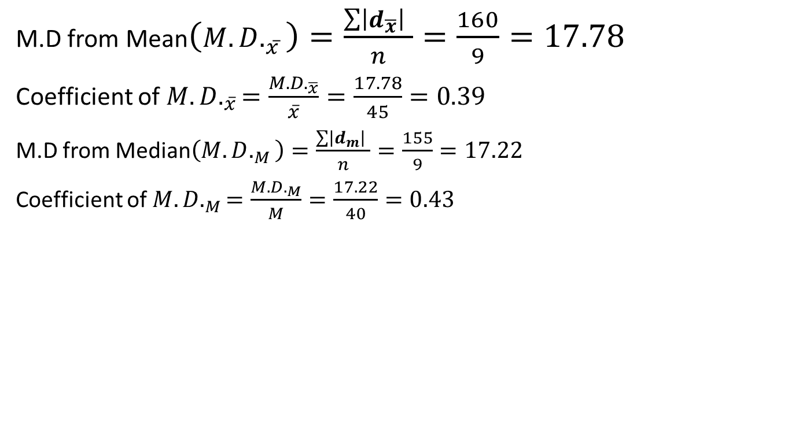
PRACTICE PROBLEMS – MEAN DEVIATION
(CO-1)
M.D from Mean$\left({M.D.}_{\overline{x}}\right)=\frac{\sum{\left|d_{\overline{x}}\right| }}{n}=\frac{160}{9}=17.78$
Coefficient of ${M.D.}_{\overline{x}}=\frac{{M.D.}_{\overline{x}}}{\overline{x}}=\frac{17.78}{45}=0.39$
M.D from Median$\left({M.D.}_{M}\right)=\frac{\sum{\left|d_{m}\right| }}{n}=\frac{155}{9}=17.22$
Coefficient of ${M.D.}_{M}=\frac{{M.D.}_{M}}{M}=\frac{17.22}{40}=0.43$

Slide 62
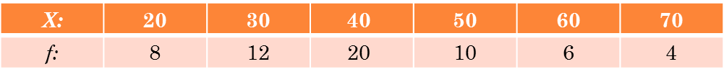
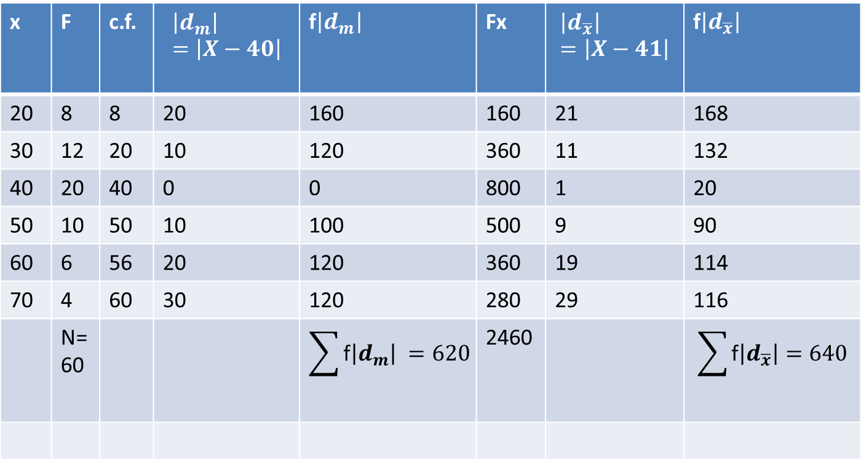
PRACTICE PROBLEMS – MEAN DEVIATION
(CO-1)
Q2: Calculate M.D. from Mean & Median & coefficient of Mean Deviation from the following data:
Solution:
x | F | c.f. | $$\left|d_{m}\right|=\left|X−40\right|$$ | f$\left|d_{m}\right|$ | Fx | $$\left|d_{\overline{x}}\right|=\left|X−41\right|$$ | f$\left|d_{\overline{x}}\right|$
20 | 8 | 8 | 20 | 160 | 160 | 21 | 168
30 | 12 | 20 | 10 | 120 | 360 | 11 | 132
40 | 20 | 40 | 0 | 0 | 800 | 1 | 20
50 | 10 | 50 | 10 | 100 | 500 | 9 | 90
60 | 6 | 56 | 20 | 120 | 360 | 19 | 114
70 | 4 | 60 | 30 | 120 | 280 | 29 | 116
 | N=60 |  |  | $$\sum{\text{f}\left|d_{m}\right| =620}$$ | 2460 |  | $$\sum{\text{f}\left|d_{\overline{x}}\right|=640}$$

Slide 63
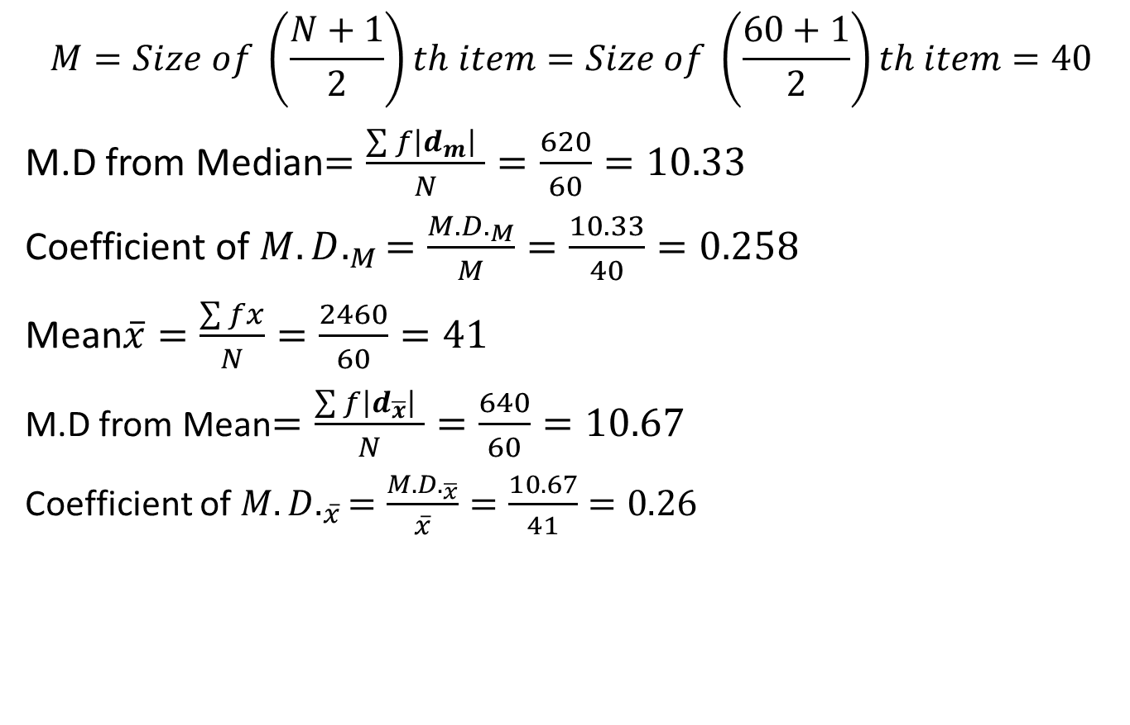
PRACTICE PROBLEMS – MEAN DEVIATION
(CO-1)
$$M=Size of \left(\frac{N+1}{2}\right)th item=Size of \left(\frac{60+1}{2}\right)th item=40$$
M.D from Median$=\frac{\sum{f\left|d_{m}\right| }}{N}=\frac{620}{60}=10.33$
Coefficient of ${M.D.}_{M}=\frac{{M.D.}_{M}}{M}=\frac{10.33}{40}=0.258$
Mean$\overline{x}=\frac{\sum{fx}}{N}=\frac{2460}{60}=41$
M.D from Mean$=\frac{\sum{f\left|d_{\overline{x}}\right| }}{N}=\frac{640}{60}=10.67$
Coefficient of ${M.D.}_{\overline{x}}=\frac{{M.D.}_{\overline{x}}}{\overline{x}}=\frac{10.67}{41}=0.26$

Slide 64
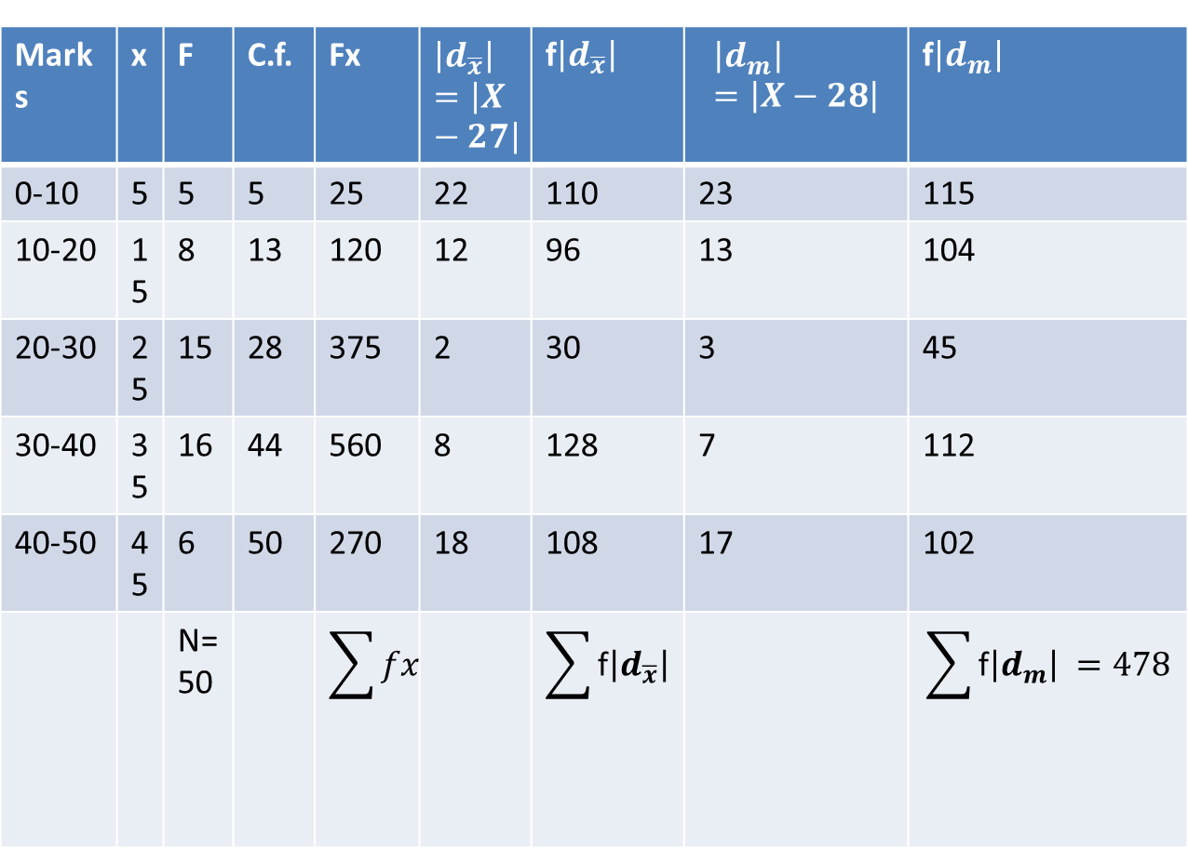
PRACTICE PROBLEMS – MEAN DEVIATION
(CO-1)
Q3: Calculate M.D. from Mean & coefficient of Mean Deviation from the following data:
Solution:
Marks | 0-10 | 10-20 | 20-30 | 30-40 | 40-50
No.of students | 5 | 8 | 15 | 16 | 6
Marks | x | F | C.f. | Fx | $$\left|d_{\overline{x}}\right|=\left|X−27\right|$$ | f$\left|d_{\overline{x}}\right|$ | $$\left|d_{m}\right|=\left|X−28\right|$$ | f$\left|d_{m}\right|$
0-10 | 5 | 5 | 5 | 25 | 22 | 110 | 23 | 115
10-20 | 15 | 8 | 13 | 120 | 12 | 96 | 13 | 104
20-30 | 25 | 15 | 28 | 375 | 2 | 30 | 3 | 45
30-40 | 35 | 16 | 44 | 560 | 8 | 128 | 7 | 112
40-50 | 45 | 6 | 50 | 270 | 18 | 108 | 17 | 102
 |  | N=50 |  | $$\sum{fx=1350}$$ |  | $$\sum{\text{f}\left|d_{\overline{x}}\right| =472}$$ |  | $$\sum{\text{f}\left|d_{m}\right| =478}$$

Slide 65
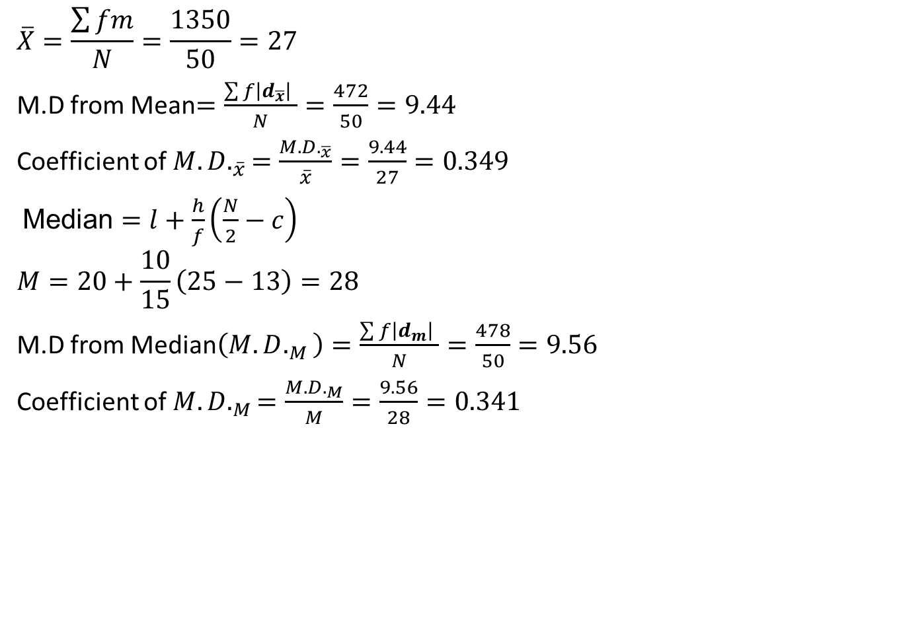
PRACTICE PROBLEMS – MEAN DEVIATION
(CO-1)
$$\overline{X}=\frac{\sum{fm}}{N}=\frac{1350}{50}=27$$
M.D from Mean$=\frac{\sum{f\left|d_{\overline{x}}\right| }}{N}=\frac{472}{50}=9.44$
Coefficient of ${M.D.}_{\overline{x}}=\frac{{M.D.}_{\overline{x}}}{\overline{x}}=\frac{9.44}{27}=0.349$
Median $=l+\frac{h}{f}\left(\frac{N}{2}−c\right)$
$$M=20+\frac{10}{15}\left(25−13\right)=28$$
M.D from Median$\left({M.D.}_{M}\right)=\frac{\sum{f\left|d_{m}\right| }}{N}=\frac{478}{50}=9.56$
Coefficient of ${M.D.}_{M}=\frac{{M.D.}_{M}}{M}=\frac{9.56}{28}=0.341$

Slide 66
MEAN DEVIATION(CO-1)
Merits
Simple to understand
Easy to compute
Less effected by extreme items
Useful in fields like Economics, Commerce etc.
Comparisons about formation of different series can be easily made as deviations are taken from a central value
Demerits
Ignoring ‘±’ signs are not appropriate
Not accurate for Mode
Difficult to calculate if value of Mean or Median comes in fractions
Not capable of further algebraic treatment
Not used in statistical conclusions.

Slide 67
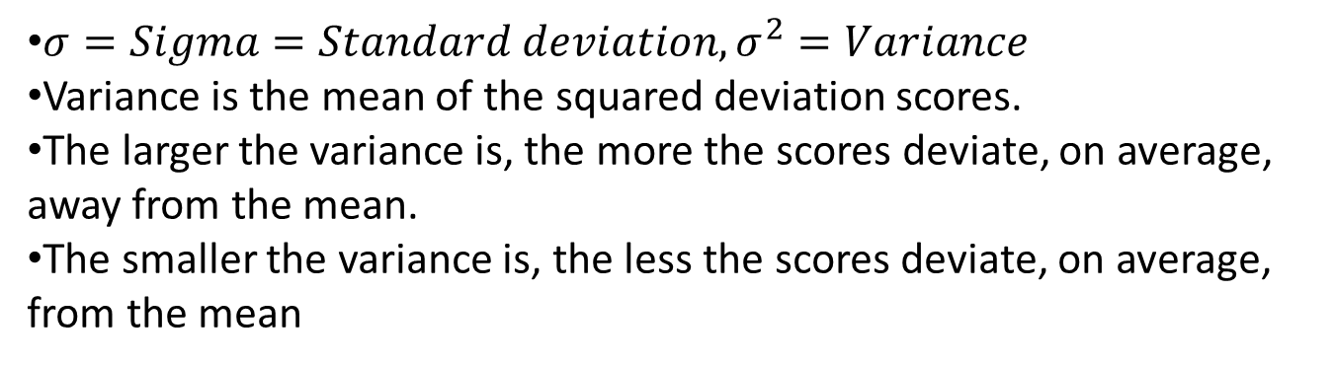
4. Variance(CO-1)
Variance is defined as the average of the square deviations:
$σ=Sigma=Standard deviation,σ^{2}=Variance$
Variance is the mean of the squared deviation scores.
The larger the variance is, the more the scores deviate, on average, away from the mean.
The smaller the variance is, the less the scores deviate, on average, from the mean

Slide 68
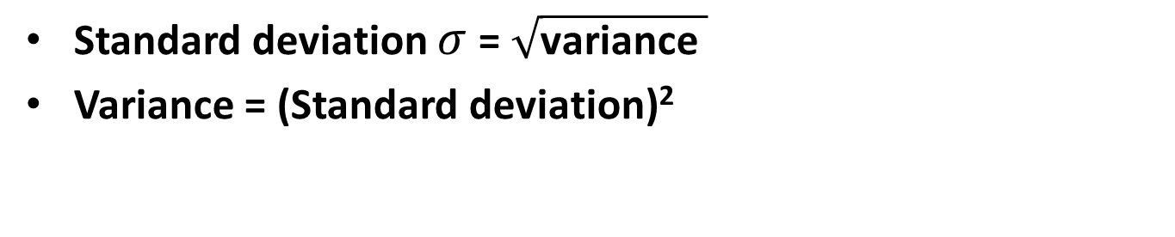
5. Standard Deviation(CO-1)
When the deviate scores are squared in variance, their unit of measure is squared as well
E.g. If people’s weights are measured in pounds, then the variance of the weights would be expressed in pounds² (or squared pounds)
Since squared units of measure are often awkward to deal with, the square root of variance is often used instead
The standard deviation is the square root of variance
Standard deviation $σ$= $\sqrt{\text{variance} }$
Variance = (Standard deviation)²

Slide 69
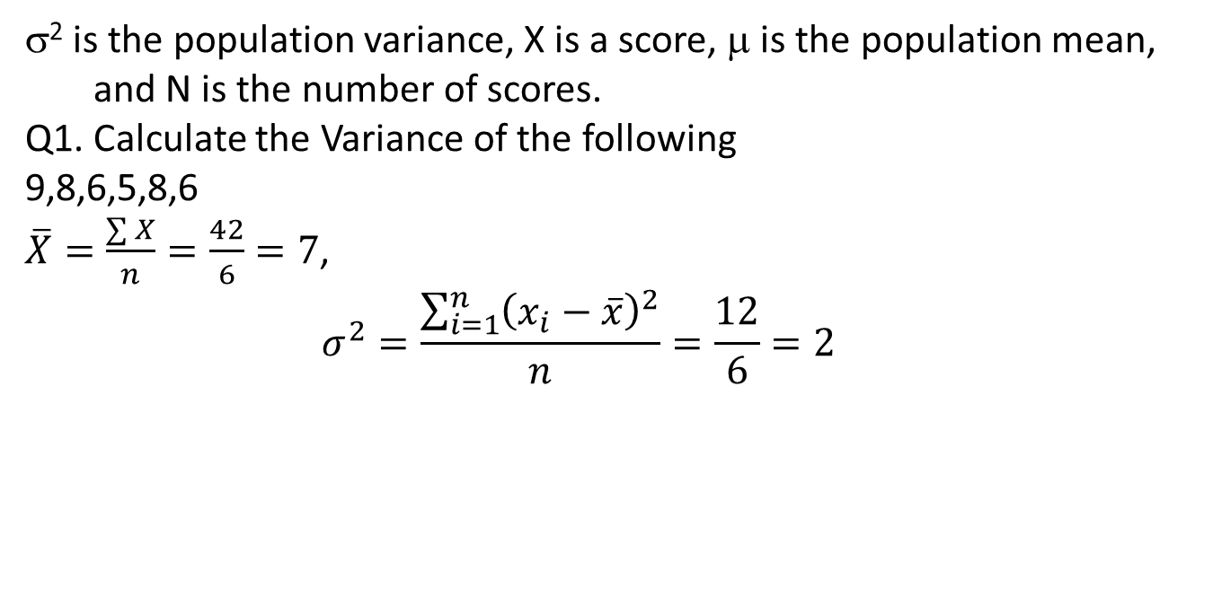
Computational Formula(CO-1)
When calculating variance, it is often easier to use a computational formula which is algebraically equivalent to the definitional formula:
σ² is the population variance, X is a score, μ is the population mean, and N is the number of scores.
Q1. Calculate the Variance of the following
9,8,6,5,8,6
$\overline{X}=\frac{\sum{X}}{n}=\frac{42}{6}=7$,
$$σ^{2}=\frac{\sum_{i=1}^{n}{{\left(x_{i}−\overline{x}\right)}^{2}}}{n}=\frac{12}{6}=2$$

Slide 70
Computational Formula Example(CO-1)

Slide 71
Computational Formula Example(CO-1)

Slide 72
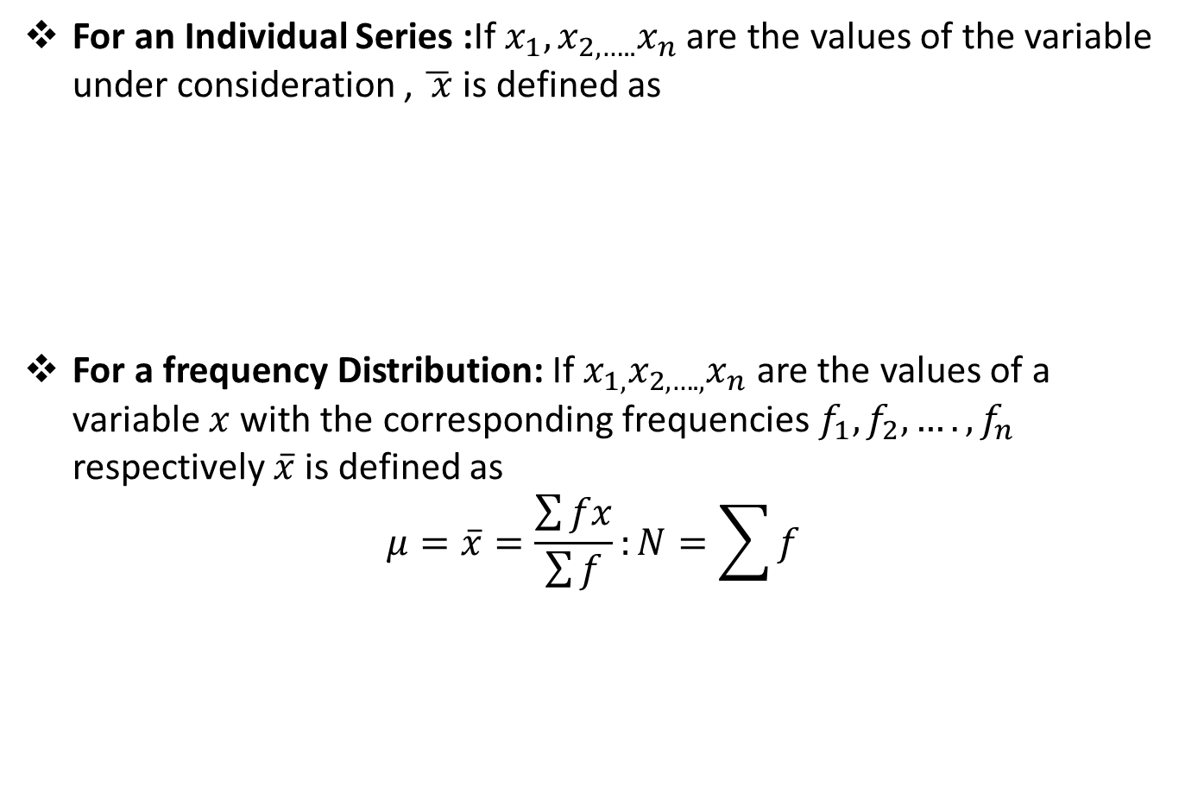

Variance (CO 1)
For an Individual Series :If $x_{1},x_{2,…..}x_{n}$ are the values of the variable under consideration , $\overline{ x}$ is defined as
For a frequency Distribution: If $x_{1,}x_{2,….,}x_{n}$ are the values of a variable $x$ with the corresponding frequencies $f_{1},f_{2},….,f_{n}$ respectively $\overline{x}$ is defined as
$$μ=\overline{x}=\frac{\sum{fx}}{\sum{f}}:N=\sum{f}$$
$$σ^{2}=\frac{\sum_{i=1}^{n}{{\left(x_{i}−\overline{x}\right)}^{2}}}{n};$$

Slide 73
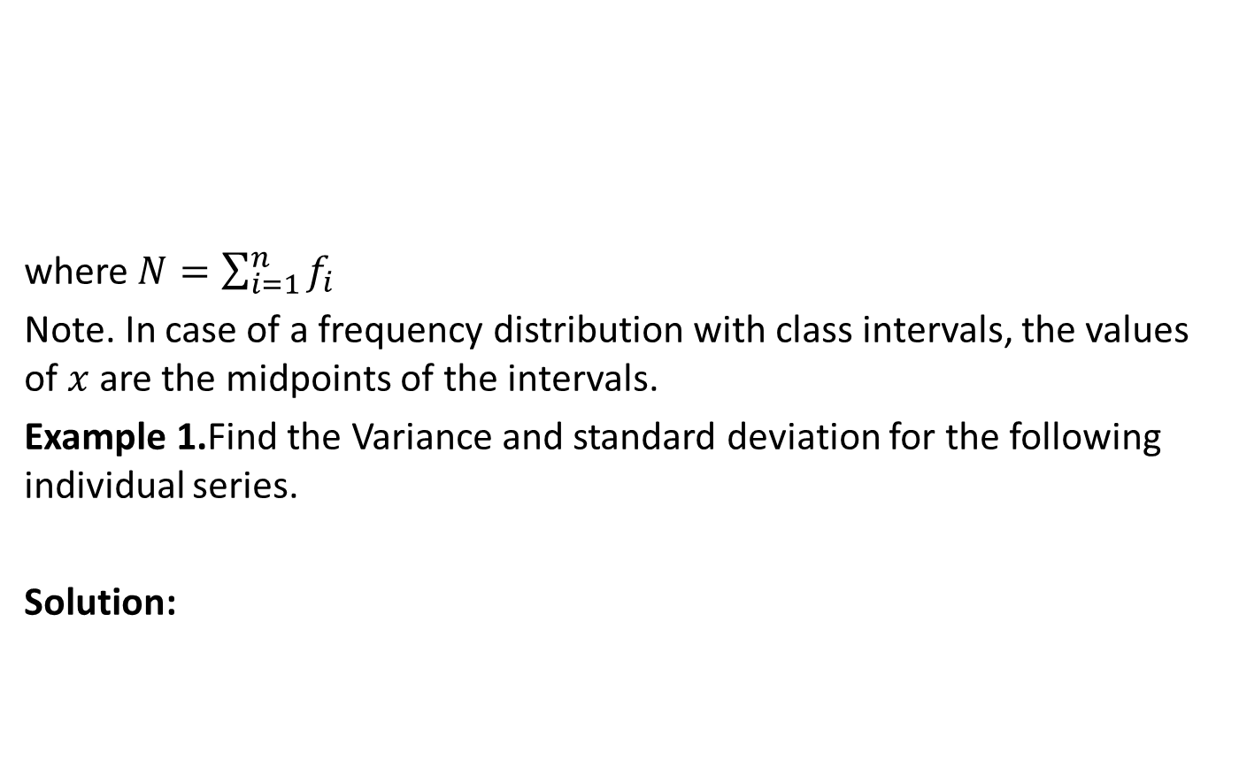

Variance (CO 1)
where $N=\sum_{i=1}^{n}{f_{i}}$
Note. In case of a frequency distribution with class intervals, the values of $x$are the midpoints of the intervals.
Example 1.Find the Variance and standard deviation for the following individual series.
Solution:
$$σ^{2}=\frac{\sum_{i=1}^{n}{{f_{i}\left(x_{i}−\overline{x}\right)}^{2}}}{N};$$
$$x$$ | 3 | 6 | 8 | 10 | 18

Slide 74
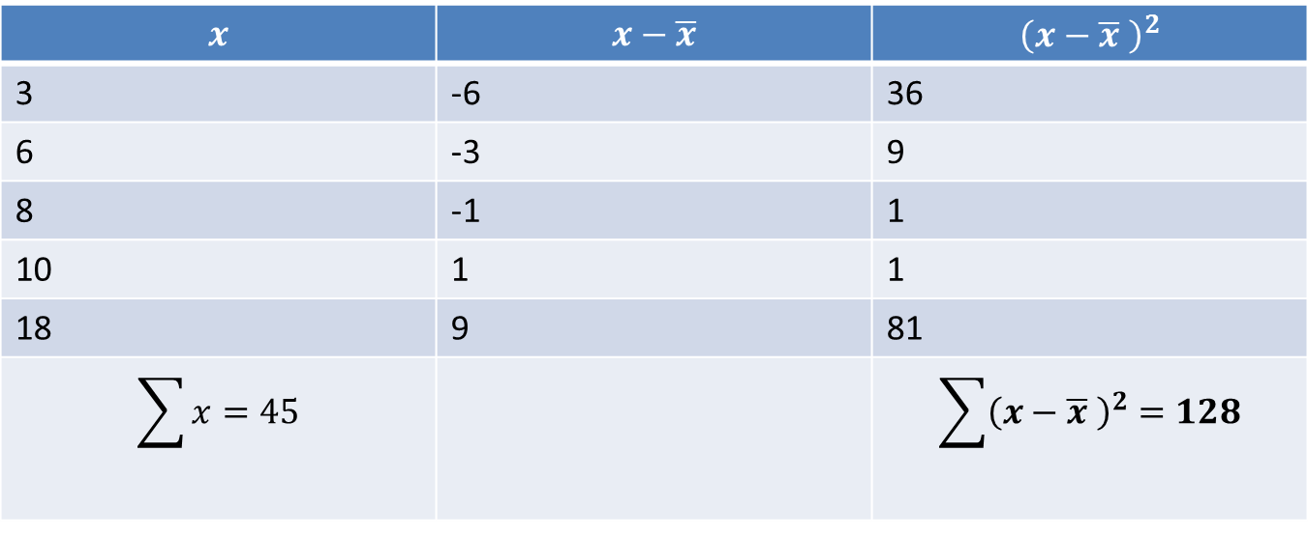
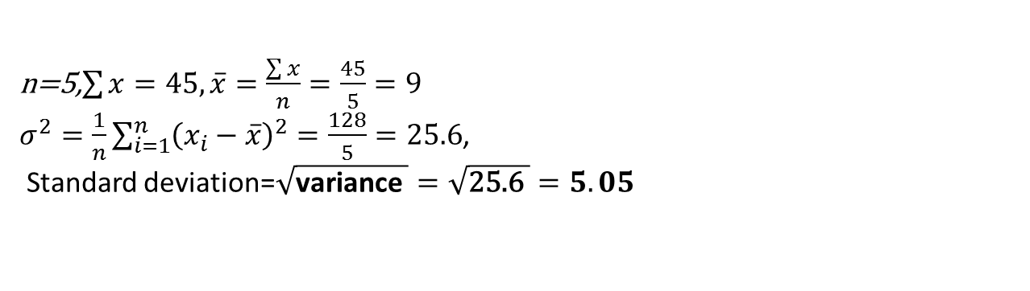
Variance (CO 1)
$$x$$ | $$x−\overline{x}$$ | $${\left(x−\overline{x} \right)}^{2}$$
3 | -6 | 36
6 | -3 | 9
8 | -1 | 1
10 | 1 | 1
18 | 9 | 81
$$\sum{x=45}$$ |  | $$\sum{{\left(x−\overline{x} \right)}^{2}}=128$$
n=5,$\sum{x}=45,\overline{x}=\frac{\sum{x}}{n}=\frac{45}{5}=9$
$σ^{2}=\frac{1}{n}\sum_{i=1}^{n}{{\left(x_{i}−\overline{x}\right)}^{2}=\frac{128}{5}=25.6}$,
Standard deviation=$\sqrt{\text{variance} }=\sqrt{\text{25.}\text{6 }}=5.05$

Slide 75
Variance (CO 1)
Example Find the variance and standard deviation for the following frequency distribution.
Sol.
Marks | 5-15 | 15-25 | 25-35 | 35-45 | 45-55 | 55-65
No.of students | 10 | 20 | 25 | 20 | 15 | 10

Slide 76
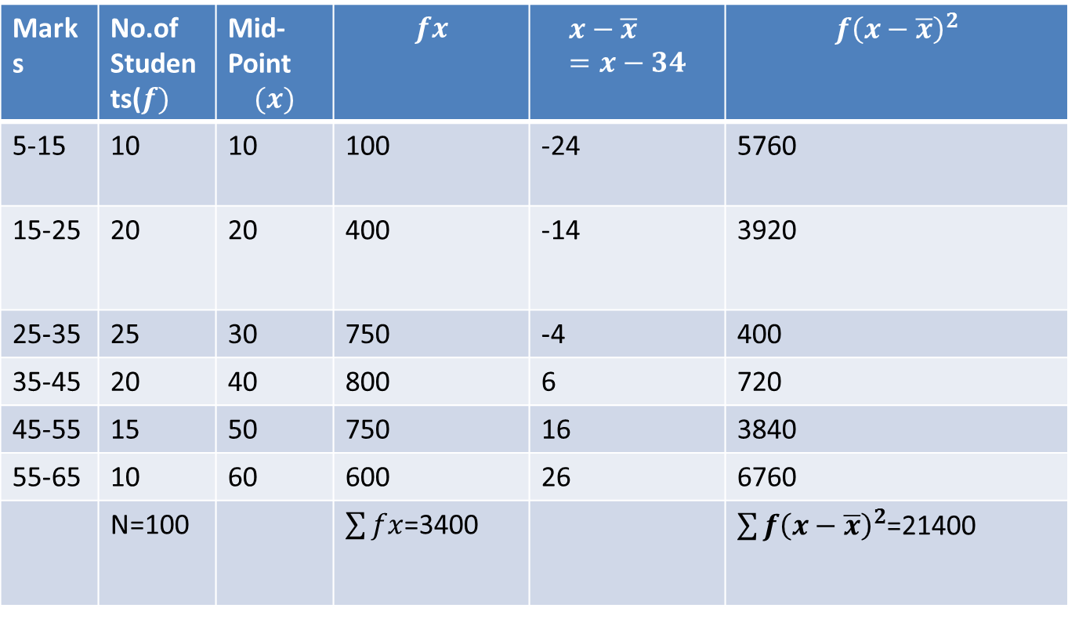
Variance (CO 1)
Marks | No.of Students($f)$ | Mid-Point $$(x)$$ | $$fx$$ | $$x−\overline{x}=x−34$$ | $$f{\left(x−\overline{x}\right)}^{2}$$
5-15 | 10 | 10 | 100 | -24 | 5760
15-25 | 20 | 20 | 400 | -14 | 3920
25-35 | 25 | 30 | 750 | -4 | 400
35-45 | 20 | 40 | 800 | 6 | 720
45-55 | 15 | 50 | 750 | 16 | 3840
55-65 | 10 | 60 | 600 | 26 | 6760
 | N=100 |  | $\sum{fx}$=3400 |  | $\sum{f{\left(x−\overline{x}\right)}^{2}}$=21400

Slide 77
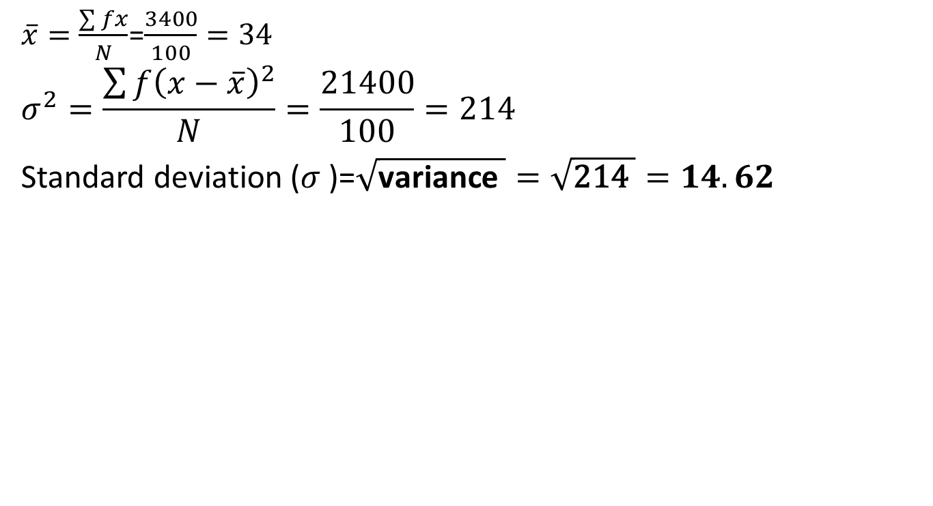
Variance (CO 1)
$\overline{x}=\frac{\sum{fx}}{N}$=$\frac{3400}{100}=34$
$$σ^{2}=\frac{\sum{f{\left(x−\overline{x}\right)}^{2}}}{N}=\frac{21400}{100}=214$$
Standard deviation ($σ$)=$\sqrt{\text{variance} }=\sqrt{\text{2}\text{14} }=14.62$

Slide 78
Daily Quiz(CO-1)
Discuss the scope of Statistics.
State the objectives and essentials of an Ideal average.
Find the mean of the following data:
15,20,30,22,25,18,40,50,55 and 65
Find the mode of the following distribution:
7,4,3,5,6,3,3,2,4,3,4,3,3,4,4,2,3

Slide 79
Topic Objective (CO1)
Moments
In mathematical statistics it involve a basic calculation. These calculations can be used to find a probability distribution's mean, variance, and skewness.

Slide 80
Moments (CO1)
Moments: The moment of a distribution are the arithmetic means of the various powers of the deviations of items from some given number.
Moments about mean (central moment)
Moments about any arbitrary number (Raw Moment)
Moments about origin

Slide 81
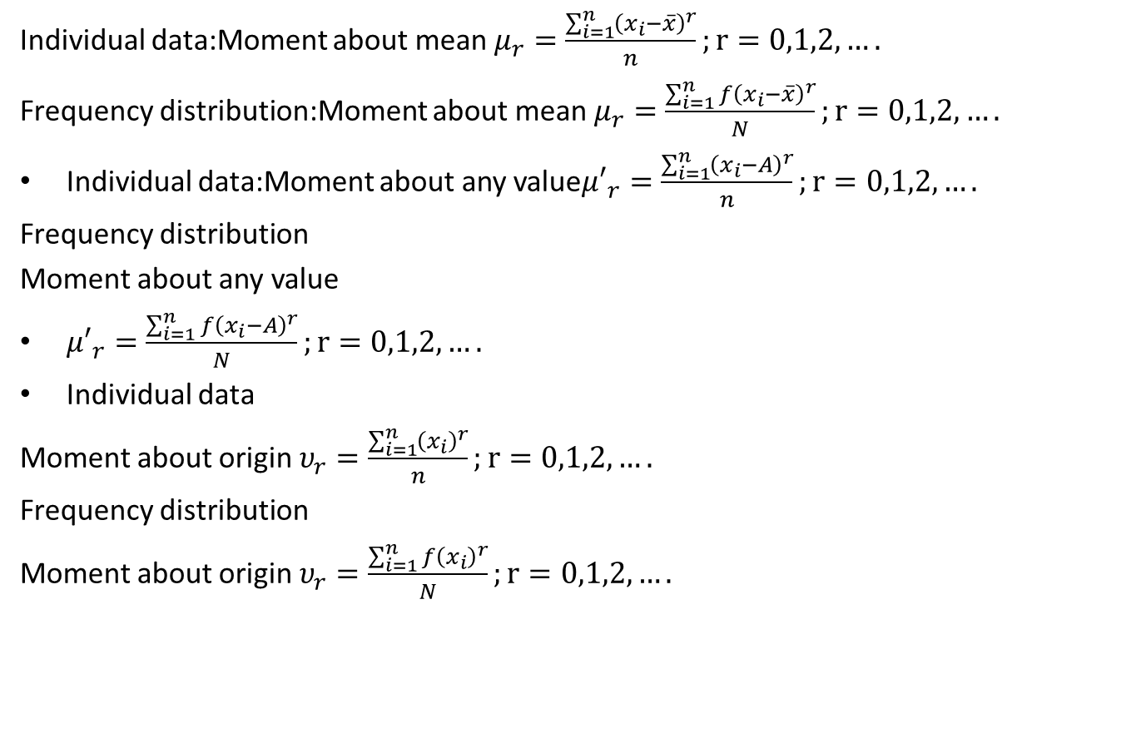
Summary (CO1)
Individual data:Momentabout mean $μ_{r}=\frac{\sum_{i=1}^{n}{{\left(x_{i}−\overline{x}\right)}^{r}}}{n};r=0,1,2,….$
Frequency distribution:Momentabout mean $μ_{r}=\frac{\sum_{i=1}^{n}{{f\left(x_{i}−\overline{x}\right)}^{r}}}{N};r=0,1,2,….$
Individual data:Momentabout any value${μ′}_{r}=\frac{\sum_{i=1}^{n}{{\left(x_{i}−A\right)}^{r}}}{n};r=0,1,2,….$
Frequency distribution
Moment about any value
${μ′}_{r}=\frac{\sum_{i=1}^{n}{{f\left(x_{i}−A\right)}^{r}}}{N};r=0,1,2,….$
Individual data
Moment about origin $υ_{r}=\frac{\sum_{i=1}^{n}{{\left(x_{i}\right)}^{r}}}{n};r=0,1,2,….$
Frequency distribution
Moment about origin $υ_{r}=\frac{\sum_{i=1}^{n}{f{\left(x_{i}\right)}^{r}}}{N};r=0,1,2,….$

Slide 82
Central Moments (CO1)
Moment about mean (central moment):
For an Individual Series :If $x_{1},x_{2,…..}x_{n}$ are the values of the variable under consideration , the $r^{th}$ moment $μ_{r}$ about mean $\overline{ x}$ is defined as
For a frequency Distribution: If $x_{1,}x_{2,….,}x_{n}$ are the values of a variable $x$ with the corresponding frequencies $f_{1},f_{2},….,f_{n}$ respectively then $r^{th}$ moment $μ_{r}$ about the mean $\overline{x}$ is defined as
Moment about mean $μ_{r}=\frac{\sum_{i=1}^{n}{{\left(x_{i}−\overline{x}\right)}^{r}}}{n};r=0,1,2,….$

Slide 83

Central Moments (CO1)
where $N=\sum_{i=1}^{n}{f_{i}}$
in particular $μ_{0}=\frac{1}{N}\sum_{i=1}^{n}{{f_{i}\left(x_{i}−\overline{x}\right)}^{0}=\frac{1}{N}\sum_{i=1}^{n}{f_{i}}=\frac{N}{N}=1}$
Note. In case of a frequency distribution with class intervals, the values of $x$are the midpoints of the intervals.
Example 1.Find the first four moments for the following individual series.
Solution: Calculation of Moments
$$μ_{r}=\frac{\sum_{i=1}^{n}{{f_{i}\left(x_{i}−\overline{x}\right)}^{r}}}{N};r=0,1,2….$$
$$x$$ | 3 | 6 | 8 | 10 | 18

Slide 84
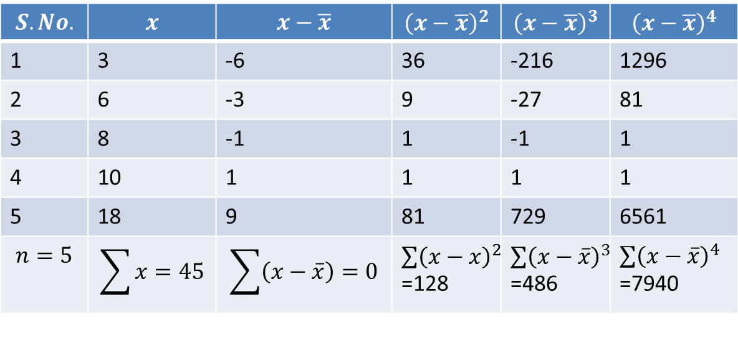
Central Moments (CO3)

Slide 85
Central Moments (CO3)
For any distribution,$μ_{0}=1$
$$μ_{1}=\frac{1}{n}\sum_{i=1}^{n}{\left(x_{i}−\overline{x}\right)=0}$$
For any distribution,$μ_{1}=0$, for r=2,
$$μ_{2}=\frac{1}{n}\sum_{i=1}^{n}{{\left(x_{i}−\overline{x}\right)}^{2}=\frac{128}{5}=25.6}$$
Therefore for any distribution ,$μ_{2}$ coincides with the variance of the distribution.
Similarly,$μ_{3}=\frac{1}{n}\sum_{i=1}^{n}{{\left(x_{i}−\overline{x}\right)}^{3}=\frac{486}{5}=97.2}$
$μ_{4}=\frac{1}{n}\sum_{i=1}^{n}{{\left(x_{i}−\overline{x}\right)}^{4}=\frac{7940}{5}=1588}$

Slide 86

Central Moments (CO3)
Now $\overline{x}=\frac{\sum{x}}{n}$=$\frac{45}{5}$=9
$μ_{1}=\frac{\sum{\left(x−\overline{x}\right)}}{n}$=$\frac{0}{5}$=$0$,
$μ_{2}=\frac{\sum{{\left(x−\overline{x}\right)}^{2}}}{n}$=$\frac{128}{5}$=$25.6$,
$μ_{3}=\frac{\sum{{\left(x−\overline{x}\right)}^{3}}}{n}$=$\frac{486}{5}$=$97.$2,
$μ_{4}=\frac{\sum{{\left(x−\overline{x}\right)}^{4}}}{n}$=$\frac{7940}{5}$=$1588$,

Slide 87

Central Moments (CO3)
For any distribution,$μ_{0}=1$ for r=1
$$μ_{1}=\frac{1}{N}\sum_{i=1}^{n}{f_{i}\left(x_{i}−\overline{x}\right)=\frac{1}{N}\sum_{i=1}^{n}{f_{i}x_{i}}−\overline{x}\left[\frac{1}{N}\sum_{i=1}^{n}{f_{i}}\right]=\overline{x}−\overline{x}=0}$$
For any distribution,$μ_{1}=0$, for r=2,
$$μ_{2}=\frac{1}{N}\sum_{i=1}^{n}{f_{i}{\left(x_{i}−\overline{x}\right)}^{2}={\left(S.D\right)}^{2}=Variance}$$
Therefore for any distribution ,$μ_{2}$ coincides with the variance of the distribution.
Similarly,$μ_{3}=\frac{1}{N}\sum_{i=1}^{n}{f_{i}{\left(x_{i}−\overline{x}\right)}^{3}}$
$μ_{4}=\frac{1}{N}\sum_{i=1}^{n}{f_{i}{\left(x_{i}−\overline{x}\right)}^{4}}$and so on.

Slide 88
Central Moments (CO3)
Example$μ_{1,}μ_{2,}μ_{3,}μ_{4 }$for the following frequency distribution.
Sol. Calculation of Moments
Marks | 5-15 | 15-25 | 25-35 | 35-45 | 45-55 | 55-65
No.of students | 10 | 20 | 25 | 20 | 15 | 10

Slide 89
Central Moments (CO3)
Marks | No.of Students($f)$ | Mid-Point $$(x)$$ | $$fx$$ | $$x−\overline{x}=x−34$$ | $$f\left(x−\overline{x}\right)$$ | $$f{\left(x−\overline{x}\right)}^{2}$$ | $$f{\left(x−\overline{x}\right)}^{3}$$ | $$f{\left(x−\overline{x}\right)}^{4}$$
5-15 | 10 | 10 | 100 | -24 | -240 | 5760 | -138240 | 3317760
15-25 | 20 | 20 | 400 | -14 | -280 | 3920 | -54880 | 768320
25-35 | 25 | 30 | 750 | -4 | -100 | 400 | -1600 | 6400
35-45 | 20 | 40 | 800 | 6 | 120 | 720 | 4320 | 25920
45-55 | 15 | 50 | 750 | 16 | 240 | 3840 | 61440 | 983040
55-65 | 10 | 60 | 600 | 26 | 260 | 6760 | 175760 | 4569760
 | N=100 |  | $\sum{fx}$=3400 |  | $\sum{f\left(x−\overline{x}\right)}$=0 | $\sum{f{\left(x−\overline{x}\right)}^{2}}$=21400 | $f{\left(x−\overline{x}\right)}^{3}$=46800 | $f{\left(x−\overline{x}\right)}^{4}$=9671200

Slide 90

Central Moments (CO3)
$\overline{x}=\frac{\sum{fx}}{N}$=$\frac{3400}{100}=34$
$$μ_{1}=\frac{\sum{f\left(x−\overline{x}\right)}}{N}=\frac{0}{100}=0$$
$$μ_{2}=\frac{\sum{f{\left(x−\overline{x}\right)}^{2}}}{N}=\frac{21400}{100}=214$$
$$μ_{3}=\frac{\sum{f{\left(x−\overline{x}\right)}^{3}}}{N}=\frac{46800}{100}=468$$
$$μ_{4}=\frac{\sum{f{\left(x−\overline{x}\right)}^{4}}}{N}=\frac{9671200}{100}=96712$$

Slide 91

Central Moments (CO3)
SHEPARD’S CORRECTIONS FOR MOMENTS:While computing moments for frequency distribution with class intervals, we take variables $x$ as the midpoint of class intervals which means that we have assumed the frequencies concentrated at the midpoints of class intervals. The above assumption is true when the distribution is symmetrical and the no. of class intervals is not greater than $\frac{1}{20}$ of the range, otherwise the computation of moments will have error called grouping error.
This error is corrected by the following formula given by W.F.Sheppard.
$$μ_{2}=μ_{2}−\frac{h^{2}}{12}$$

Slide 92

Central Moments (CO3)
$$μ_{4}=μ_{4}−\frac{1}{2}h^{2}μ_{2}+\frac{7}{240}h^{4}$$
Where h is the width of class interval while $μ_{2}{and μ}_{3}$ require no correction. These formulae are known as Sheppard’s corrections.
Example: Find the corrected values of the following moments using Sheppard's correction. The width of classes in the distribution is 10.
$$μ_{2}=214 μ_{3}=468 μ_{4}=96712$$
Sol. We have $μ_{2}=214 μ_{3}=468 μ_{4}=96712$ h=10
$$μ_{2}(corrected)=μ_{2}−\frac{h^{2}}{12}=214−\frac{{\left(10\right)}^{2}}{12}=214−8.333=205.667$$
$$μ_{3}\left(corrected\right)=μ_{3}=468$$

Slide 93
Central Moments (CO3)
$$μ_{4}\left(corrected\right)=μ_{4}−\frac{1}{2}h^{2}μ_{2}+\frac{7}{240}h^{4}$$
$$=96712−\frac{{\left(10\right)}^{2}}{2}\left(214\right)+\frac{7}{240}{\left(10\right)}^{4}$$
$$=96712−10700−291.667=86303.667.$$

Slide 94
Raw Moments (CO3)
MOMENTS ABOUT AN ARBITARY NUMBER(Raw Moments):
If $x_{1},x_{2},x_{3},…..,x_{n}$ are the values of a variable $x$with the corresponding frequencies $f_{1},f_{2},f_{3,…..}f_{n}$ respectively then $r^{th }$moment $μ_{r}′$ about the number $x=A$is defined as
Where,$N=\sum_{i=1}^{n}{fi}$
For $r=0, {μ′}_{0}=\frac{1}{N}\sum_{i=1}^{n}{f_{i}{\left(x_{i}−A\right)}^{0}}=1$
${μ′}_{r}=\frac{1}{N}\sum_{i=1}^{n}{f_{i}{\left(x_{i}−A\right)}^{r};r=0,1,2,…}$

Slide 95

Raw Moments (CO3)
For $r=1, {μ′}_{1}=\frac{1}{N}\sum_{i=1}^{n}{f_{i}\left(x_{i}−A\right)}=\frac{1}{N}\sum_{i=1}^{n}{f_{i}x_{i}}−\frac{A}{N}\sum_{i=1}^{n}{fi}=\overline{x}−A$
For $r=2, {μ′}_{2}=\frac{1}{N}\sum_{i=1}^{n}{f_{i}{\left(x_{i}−A\right)}^{2}}$
For $r=3, {μ′}_{3}=\frac{1}{N}\sum_{i=1}^{n}{f_{i}{\left(x_{i}−A\right)}^{3}}$and so on.
In Calculation work, if we find that there is some common factor $h$(>1) in values of $x−A,$we can ease our calculation work by defining $u=\frac{x−A}{h}.$
In that case , we have
$${μ′}_{r}=\frac{1}{N}\left(\sum_{i=1}^{n}{f_{i}{u_{i}}^{r}}\right)h^{r};r=0,1,2,….$$

Slide 96

Raw Moments (CO3)
Note:For an individual series,
1. ${μ′}_{r}=\frac{1}{n}\sum_{i=1}^{n}{{\left(x_{i}−A\right)}^{r}};r=0,1,2,….$
2.${ μ′}_{r}=\frac{1}{n}\left(\sum_{i=1}^{n}{{u_{i}}^{r}}\right)h^{r};r=0,1,2,….$

Slide 97

Moments about the origin (CO3)
MOMENTS ABOUT THE ORIGIN:
If $x_{1},x_{2},……,x_{n}$ be the values of a variable $x$ with corresponding frequencies $f_{1},f_{2},……,f_{n}$respectively then $r^{th }$moment about the origin $v_{r}$is defined as
Where, $N=\sum_{i=1}^{n}{f_{i}}$
For $r=0, v_{0}=\frac{1}{N}\sum_{i=1}^{n}{f_{i}{x_{i}}^{0}=}\frac{N}{N}=1$
For $r=1, v_{1}=\frac{1}{N}\sum_{i=1}^{n}{f_{i}x_{i}=}\overline{x}$
For $r=2, v_{2}=\frac{1}{N}\sum_{i=1}^{n}{f_{i}{x_{i}}^{2}}$ and so on.
$v_{r}=\frac{1}{N}\sum_{i=1}^{n}{f_{i}{x_{i}}^{r}};r=0,1,2,….$

Slide 98
Relations (CO3)
RELATION BETWEEN $μ_{r} AND {μ′}_{r}:$
We know that,
$$μ_{r}=\frac{\sum_{i=1}^{n}{f_{i}{\left(x_{i}−\overline{x}\right)}^{r}}}{N}$$
$$=\frac{1}{N}\sum_{i=1}^{n}{f_{i}{\left[\left(x_{i}−A\right)−\left(\overline{x}−A\right)\right]}^{r}}$$
$$=\frac{1}{N}\sum_{i=1}^{n}{f_{i}}{\left[\left(x_{i}−A\right)−{μ′}_{1}\right]}^{r}=\frac{1}{N}\sum_{i=1}^{n}{f_{i}}\left[{\left(x_{i}−A\right)}^{r}−{}_{}^{r}{C_{1}{\left(x_{i}−A\right)}^{r−1}{μ′}_{1}+{}_{}^{r}{C_{2}{\left(x_{i}−A\right)}^{r−2}{μ_{1}′}^{2}−…+{\left(−1\right)}^{r}{μ_{1}′}^{r}}}\right]$$

Slide 99

Relations (CO3)
Using binomial theorem:
$$=\frac{1}{N}\sum_{i=1}^{n}{f_{i}}\left[{\left(x_{i}−A\right)}^{r}−{}_{}^{r}{C_{1}{\left(x_{i}−A\right)}^{r−1}{μ′}_{1}+{}_{}^{r}{C_{2}{\left(x_{i}−A\right)}^{r−2}{μ_{1}′}^{2}−…+{\left(−1\right)}^{r}{μ_{1}′}^{r}}}\right]$$
$$μ_{r}={μ′}_{r}−{}_{}^{r}{C_{1}{μ′}_{r−1}{μ′}_{1}+{}_{}^{r}{C_{2}}}{μ′}_{r−2}{μ_{1}′}^{2}−…+{\left(−1\right)}^{r}{μ_{1}′}^{r}$$
Putting r=2,3,4, we get
$$μ_{2}={μ′}_{2}−2{μ_{1}′}^{2}+{μ_{1}′}^{2}=μ_{2}^{′}−{μ_{1}′}^{2}$$
$$μ_{3}={μ′}_{3}−3 μ_{2}^{′}μ_{1}^{′}+{3μ_{1}′}^{3}−{μ_{1}′}^{3}=μ_{3}^{′}−3μ_{2}^{′}μ_{1}′+2{μ_{1}′}^{3}$$
$$μ_{4}={μ′}_{4}−4{μ^{′}}_{3}μ_{1}^{′}+6μ_{2}^{′{μ_{1}′}^{2}}−3{μ_{1}′}^{4}$$
ence, we have the following relations:
$$μ_{1}=0$$
$$μ_{2}=μ_{2}′−{μ_{1}′}^{2}$$

Slide 100

Relations (CO3)
$$μ_{3}=μ_{3}′−3μ_{2}′μ_{1}′+2{μ_{1}′}^{3}$$
$$μ_{4}=μ_{4}^{′}−4μ_{3}^{′}μ_{1}′+6μ_{2}′{μ_{1}′}^{2}−3{μ_{1}′}^{4}$$
RELATION BETWEEN $v_{r} AND μ_{r}$
$$v_{1}=\overline{x}$$
$$v_{2}=μ_{2}+{\overline{x}}^{2}$$
$$v_{3}=μ_{3}+3μ_{2}\overline{x}+{\overline{x}}^{3}$$
$$v_{4}=μ_{4}+4μ_{3}\overline{x}+6μ_{2}{\overline{x}}^{2}+{\overline{x}}^{4}$$

Slide 101

KARL PERSON’S COEFFICIENTS(CO3)
KARL PERSON’S $β AND γ$ COEFFICIENTS:
Karl Pearson defined the following four coefficients based upon the first four moments of a frequency distribution about it mean:
The practical use of this coefficients is to measure the skewness and kurtosis of a frequency distribution .These coefficients are pure numbers independent of units of measurement.
$β_{1}=\frac{{μ_{3}}^{2}}{{μ_{2}}^{3}}$$β_{2}=\frac{μ_{4}}{{μ_{2}}^{2}}$ ($β−$coefficients)
$γ_{1}=+\sqrt{β_{1}}$$γ_{2}=β_{2}−3$ ($γ−$coefficients)

Slide 102
KARL PERSON’S COEFFICIENTS(CO3)
Example1 : The first three moments of a distribution about the value “2” of the variable are 1,16 and $−$40.Show that the mean is 3,variance is 15 and $μ_{3}=−86.$
Solution: We have A=2,${μ′}_{1}=1$,${μ′}_{2}=16$ and ${μ′}_{3}=−40$
We have that ${μ′}_{1}=\overline{x}−A⟹\overline{x}={μ′}_{1}+A=1+2=3$
Variance=$μ_{2}={μ′}_{2}−{{μ′}_{1}}^{2}=16−{\left(1\right)}^{2}=15$
$$μ_{3}={μ′}_{3}−3{μ^{′}}_{2}{μ^{′}}_{1}+2{{μ^{′}}_{1}}^{3}=−40−3\left(16\right)\left(1\right)+2{\left(1\right)}^{3}=−40−48+2=−86.$$

Slide 103

KARL PERSON’S COEFFICIENTS(CO3)
Example 2:The first moments of a distribution about the value “35” are$−1.8,240,−1020 and 144000.$Find the values of $μ_{1},μ_{2},μ_{3},μ_{4.}$
Solution:$μ_{1}=0$
$$μ_{2}={μ′}_{2}−{μ_{1}′}^{2}=240−{\left(−1.8\right)}^{2}=236.76$$
$μ_{3}={μ′}_{3}−3{μ′}_{2}{μ′}_{1}+$2${{μ′}_{1}}^{3}$
$$=−1020−3\left(240\right)\left(−1.8\right)+2{\left(−1.8\right)}^{3}=264.36$$
$$μ_{4}={μ′}_{4}−4{μ^{′}}_{3}{μ^{′}}_{1}+6{μ^{′}}_{2}{{μ^{′}}^{2}}_{1}−3{{μ^{′}}^{4}}_{1}=144000−4\left(−1020\right)\left(−1.8\right)+6\left(240\right){\left(−1.8\right)}^{2−}3{\left(−1.84\right)}^{4}=141290.11.$$

Slide 104


KARL PERSON’S COEFFICIENTS(CO3)
Example 3:Calculate the variance and third central moment from the following data.
Solution: Calculation of Moments
$$x_{i}$$ | 0 | 1 | 2 | 3 | 4 | 5 | 6 | 7 | 8
$$F_{i}$$ | 1 | 9 | 26 | 59 | 72 | 52 | 29 | 7 | 1
$$x$$ | $$f$$ | $u=\frac{x−A}{h}$, $A=4,h=1$ | $$f_{u}$$ | $${fu}^{2}$$ | $${fu}^{3}$$
0 | 1 | -4 | -4 | 16 | -64
1 | 9 | -3 | -27 | 81 | -243
2 | 26 | -2 | -52 | 104 | -208
3 | 59 | -1 | -59 | 59 | -59
4 | 72 | 0 | 0 | 0 | 0

Slide 105


KARL PERSON’S COEFFICIENTS(CO3)
$${μ′}_{1}=\left(\frac{\sum{fu}}{N}\right)h=\frac{−7}{256}=−0.02734$$
${μ′}_{2}=\left(\frac{\sum{fu^{2}}}{N}\right)h^{2}=\frac{507}{256}=$1.9805

Slide 106

KARL PERSON’S COEFFICIENTS(CO3)
$${μ′}_{3}=\left(\frac{\sum{fu^{3}}}{N}\right)h^{3}=\frac{−37}{256}=−0.1445$$
Moments about Mean:
$$μ_{1}=0$$
$$μ_{2}={μ′}_{2}−{{μ^{′}}_{1}}^{2}=1.9805−{\left(−.02734\right)}^{2}=1.97975$$
Variance=1.97975
Also $μ_{3}={μ′}_{3}−3{μ′}_{2}{μ′}_{1}+2{μ_{1}′}^{3}$
$$=\left(−0.1445\right)−3\left(1.9805\right)\left(−0.02734\right)+2{\left(−0.02734\right)}^{3}$$
=0.0178997
Third central moment$=0.0178997.$

Slide 107

KARL PERSON’S COEFFICIENTS(CO3)
Example 4: The first four moments of a distribution about the value ‘4’of the
variable are -1.5,17,$−30$and 108.Find the moments about mean, about origin;$β_{1} and β_{2}$also find the moments about the point $x=2.$
Solution: We have A=4,${μ′}_{1}=−1.5,{μ^{′}}_{2}=17,{μ^{′}}_{3}=−30,{μ^{′}}_{4}=108$
Moments about mean
$$μ_{1}=0$$
$$μ_{2}={μ′}_{2}−{μ_{1}′}^{2}=14.75$$
$$μ_{3}={μ′}_{3}−3{μ^{′}}_{2}{μ^{′}}_{1}+2{μ_{1}′}^{3}=39.75$$
$$μ_{4}={μ′}_{4}−4{μ^{′}}_{3}{μ^{′}}_{1}+6{μ^{′}}_{2}{μ_{1}′}^{2}−3{μ_{1}′}^{4}=142.3125$$
$$\overline{x}={μ′}_{1}+A=−1.5+4=2.5$$

Slide 108

KARL PERSON’S COEFFICIENTS(CO3)
Moments about origin:
$$v_{1}=\overline{x}=2.5$$
$$v_{2}=μ_{2}+{\overline{x}}^{2}=14.75+{\left(2.5\right)}^{2}=21$$
$$v_{3}=μ_{3}+3μ_{2}\overline{x}+{\overline{x}}^{3}=166$$
$$v_{4}=μ_{4}+4μ_{3}\overline{x}+6μ_{2}{\overline{x}}^{2}+{\overline{x}}^{4}=1132$$
Calculation of $β_{1} and β_{2}$
$β_{1}=\frac{{μ_{3}}^{2}}{{μ_{2}}^{3}}$=0.492377 $β_{2}=\frac{μ_{4}}{{μ_{2}}^{2}}$=0.654122
Moments about the points$x=2$
$${μ′}_{1}=\overline{x}−A=2.5−2=0.5$$
$${μ′}_{2}=μ_{2}+{μ_{1}′}^{2}=14.75+{\left(.5\right)}^{2}=15$$
$${μ′}_{3}=μ_{3}+3{μ′}_{2}{μ′}_{1}−2{μ_{1}′}^{3}=39.75+3\left(15\right)\left(.5\right)−2{\left(.5\right)}^{3}=62$$
${μ′}_{4}=μ_{4}+4{μ′}_{3}{μ′}_{1}−6{{μ^{′}}_{2}μ_{1}′}^{2}+3{μ_{1}′}^{4}=$244

Slide 109
Daily Quiz(CO3)
Q1. The first four moments of a distribution are 3, 10.5,40.5,168.Comment upon the nature of the distribution.
Q2. For a distribution, the mean is 10,variance is 16,$γ_{1}$ is 1 and $β_{2}$ is 4. Find the first four moment about origin.

Slide 110
Topic objective (CO3)
Skewness
It tells us whether the distribution is normal or not
It gives us an idea about the nature and degree of concentration of observations about the mean
The empirical relation of mean, median and mode are based on a moderately skewed distribution

Slide 111
Skewness(CO3)
Skewness:
I t means lack of symmetry.
It gives us an idea about the shape of the curve which we can draw with the help of the given data.
A distribution is said to be skewed if—
Mean, median and mode fall at different points, i.e.,
Mean ƒ= Median ƒ= Mode;
Quartiles are not equidistant from median; and
The curve drawn with the help of the given data is not symmetrical but stretched more to one side than to the other.

Slide 112

Skewness(CO3)
Symmetrical Distribution
A symmetric distribution is a type of distribution where the left side of the distribution mirrors the right side. In a symmetric distribution, the mean, mode and median all fall at the same point.

Slide 113
Skewness(CO3)
Measures of Skewness:
The measures of skewness are:
S_{k} = M − M_{d} ,
S_{k} = M − M_{o} ,
S_{k} = (Q₃ − M_{d} ) − (M_{d} − Q₁),
where M is the mean, M_{d} , the median, M_{o} , the mode, Q₁, the first quartile deviation and Q₃, the third quartile deviation of the distribution.
These are the absolute measures of skewness.
Coefficients of Skewness: For comparing two series we do not calculate these absolute measures but we calculate the relative measures called the coefficients of skewness which are pure numbers independent of units of measurement.

Slide 114
Skewness(CO3)
The following are the coefficients ofskewness:
Prof. Karl Pearson’s Coefficient of Skewness,
Prof. Bowley’sCoefficient of Skewness,
Coefficient of Skewness based uponMoments.
Prof. Karl Pearson’s Coefficientof Skewness:
Definition
It is definedas:
$${SK}_{p}=\frac{A.M.−Mode}{S.D}=\frac{3\left(M−\text{M}\text{d}\right)}{\text{σ}}$$
where σ is the standard deviation of the distribution. If mode is ill-
$Mode$=3Median-2mean

Slide 115
Skewness(CO3)
defined, then using the empirical relation,
M_{o} = 3M_{d} − 2M, for a moderately asymmetrical distribution, we have
From above two formulas, we observe that S_{k} = 0 if M = M_{o} = M_{d} .
Hence for a symmetrical distribution, mean, median and mode coincide.
Skewness is positive if M > M_{o} or M > M_{d} , and negative if M < M_{o} or M < M_{d} .
Limits are: |S_{k} | ≤ 3 or −3 ≤ S_{k} ≤ 3.
However, in practice, these limits are rarely attained.

Slide 116
Skewness(CO3)
Coefficient of Skewness basedupon Moments
Definition
It is definedas:$γ_{1}=\frac{μ_{3}}{\sqrt{{μ_{2}}_{}^{3}}}$
where $γ_{1}$are Pearson’s Coefficients and definedas:
S_{k}= 0, if either $β_{1}$= 0 or $β_{2}$= −3. Thus S_{k}= 0, if and only if $β_{1}$=0.
Thus for a symmetrical distribution $β_{1}$=0.
In this respect $β_{1}$is taken as a measure ofskewness.

Slide 117

Skewness(CO3)
The coefficient of skewness based upon moments is to be regarded as without sign.
The Pearson’s and Bowley’s coefficients of skewness can be positive as well as negative.
Positively Skewed Distribution: The skewness is positive if the larger tail of the distribution lies towards the higher values of the variate (the right),i.e., if the curve drawn
with the help of the given data is
stretched more to the right than
to the left.

Slide 118

Skewness(CO3)
Negatively Skewed Distribution:
The skewness is negative if the larger tail of the distribution lies towards the lower values of the variate (the left), i.e., if the curve drawn with the help of the given data is stretched more to the left than to the right.

Slide 119

Skewness(CO3)
Pearson’s $β_{1}$and $γ_{1}$Coefficients:
$$γ_{1}=\sqrt{β_{1}}=±\frac{μ_{3}}{\sqrt{{μ_{2}}_{}^{3}}}$$
Q1. Karl Pearson coefficient of skewness of a distribution is 0.32, its standard deviation is 6.5 and mean is 29.6. find the mode of the distribution.
Solution: Given that ${SK}_{p}=0.32,$$\text{σ}\text{=}\text{6.5 }\text{mean}\text{ =}\text{29.6}$
$${SK}_{p}=\frac{A.M.−Mode}{S.D}=\frac{3\left(M−\text{M}\text{d}\right)}{\text{σ}}$$
$$0.32=\frac{29.6−Mode}{6.5}⟹Mode=27.52$$

Slide 120
Topic objective (CO3)
Kurtosis
Describe the concepts of kurtosis
Explain the different measures of kurtosis
Explain how kurtosis describe the shape of a distribution.

Slide 121

Kurtosis (CO3)
Kurtosis
If we know the measures of central tendency, dispersion and skewness, we still cannot form a complete idea about the distribution. Let us consider the figure in which all the three curves
A, B, and C are symmetrical about the mean and have the same range.

Slide 122

Kurtosis (CO3)
Definition: Kurtosis is also known as Convexity of the Frequency Curvedue to Prof. KarlPearson.
It enables us to have an idea about the flatness or peaknessof the frequencycurve.
It is measure by the coefficient β₂ or its derivationγ₂ givenas:
$$β_{2}=\frac{μ_{4}}{{μ_{2}}^{2}}$$
Curve of the type A which is neither flat nor peakedis called the normal curve or mesokurticcurveand for such curve $β_{2}$= 3, i.e., γ₂ =0.
Curve of the type B which is flatter than the normal curveis known as platycurtic curveand for such curve $β_{2}$<3, i.e., γ₂ <0.

Slide 123
Kurtosis (CO3)
Curve of the type C which is more peaked than the normal curveis called leptokurtic curveand for such curve $β_{2}$>3, i.e., γ₂ >0.
Q2. Foradistribution,themeanis10,varianceis16,γ₁is+1and $β_{2}$is 4. Comment about the nature ofdistribution. Also find third central moment.
Solution$1=±\frac{μ_{3}}{\sqrt{4096}}⇒μ_{3}$=64,$μ_{2}$=16,
$$4=\frac{μ_{4}}{256}⇒μ_{4}=1024$$
Since γ₁ = +1, the distribution is moderately positively skewed,i.e,
if we draw the curve of the given distribution, it will have longer tail towards theright.
Further, since $β_{2}$= 4 >3, the distribution is leptokurtic, i.e.,
it will be sightlymore peakedthan the normalcurve.

Slide 124
Kurtosis (CO3)
Example 3 The first four moment about the working mean 28.5 of a distribution are 0.294,7.144,42.409 and 454.98. Calculate the first four moment about mean. Also evaluate $β_{1}$ and $β_{2}$and comment upon the skewness and kurtosis of the distribution.
Solution:${μ′}_{1}=.294$,${μ′}_{2}=7.144,{μ′}_{3}=42.409,{μ′}_{4}=454.98$Moment about mean
$$μ_{1}=0,$$
$$μ_{2}=μ_{2}^{′}−{μ_{1}′}^{2}=7.0576.$$
$$μ_{3}=μ_{3}^{′}−3μ_{2}^{′}μ_{1}′+2{μ_{1}′}^{3}=36.1588,$$
$$μ_{4}=μ_{4}^{′}−4μ_{3}^{′}μ_{1}^{′}+6μ_{2}^{′}{μ_{1}′}^{2}−3{μ_{1}′}^{4}=408.7896$$

Slide 125

Kurtosis (CO3)
$$β_{1}=\frac{{μ^{2}}_{3}}{{μ_{2}}_{}^{3}}=3.7193,$$
$$β_{2}=\frac{μ_{4}}{{μ_{2}}^{2}}=8.207$$
Skewness :$β_{1}$ is positive so ${γ }_{1}=1.9285 so distribution is positivley skewed.$
Kurtosis: $β_{2}=8.207>3$ so distribution is leptokutic.

Slide 126
Daily Quiz(CO3)
Q1. Find all four central moments and Discuss Skewness and Kurtosis for the following distribution-
Range of Expenditures | 2-4 | 4-6 | 6-8 | 8-10 | 10-12
No. of families | 38 | 292 | 389 | 212 | 69

Slide 127
Daily Quiz(CO3)
x | f | fx | $x−\overline{x}=$ x-7 | F(x-7) | F(x-7)*2 | F(x-7)*3 | F(x-7)*4
3 | 38 | 114 | -4 | -152 | 608 | -2432 | 9728
5 | 292 | 1460 | -2 | -584 | 1168 | -2336 | 4672
7 | 389 | 2723 | 0 | 0 | 0 | 0 | 0
9 | 212 | 1908 | 2 | 424 | 848 | 1696 | 3392
11 | 69 | 759 | 4 | 276 | 1104 | 4416 | 17664
 | 1000 | 6964 |  | 0 | 3728 | 1344 | 35456

Slide 128
Kurtosis (CO3)
$$\overline{x}=\frac{\sum{fx}}{\sum{f}}=\frac{6964}{1000}=6.964=7$$
Moment about mean
$$μ_{1}=\frac{\sum{f(x−}\overline{x})}{\sum{f}}=0,$$
$$μ_{2}=\frac{\sum{f{(x−\overline{x})}^{2} }}{\sum{f}}=3.728. μ_{3}=\frac{\sum{f{(x−\overline{x})}^{3} }}{\sum{f}}=1.344$$
$$μ_{4}=\frac{\sum{f{(x−\overline{x})}^{4} }}{\sum{f}}=35.456$$
$$β_{1}=\frac{{μ^{2}}_{3}}{{μ_{2}}_{}^{3}}=\frac{{(1.344)}^{2}}{{(3.3728)}^{3}}=0.034,$$
$$β_{2}=\frac{μ_{4}}{{μ_{2}}^{2}}=\frac{35.456}{({3.728)}^{2}}=2.554$$
Skewness :$β_{1}$ is positive so ${γ }_{1}=0.184 so distribution is positivley skewed.$
Kurtosis: $β_{2}=2.554<3$ so distribution is platykurtic.

Slide 129

Skewness & Kurtosis (CO3)
Example : The First four moments of a distribution about $x=4$are $1, 4, 10, and 45.$Find the first four moments about mean. Discuss the Skewness and Kurtosis and also comment upon the nature of the distribution.
Solution: Here We have$A=4, {μ′}_{1}=1,{μ^{′}}_{2}=4,$
$${μ^{′}}_{3}=10,{μ^{′}}_{4}=45$$
Moments about mean
$$μ_{1}=0$$
$$μ_{2}={μ′}_{2}−{μ_{1}′}^{2}=4−{\left(1\right)}^{2}=3$$
$$μ_{3}={μ′}_{3}−3{μ^{′}}_{2}{μ^{′}}_{1}+2{μ_{1}′}^{3}=10−3\left(4\right)\left(1\right)+2{\left(1\right)}^{3}=0$$
$$μ_{4}={μ′}_{4}−4{μ^{′}}_{3}{μ^{′}}_{1}+6{μ^{′}}_{2}{μ_{1}′}^{2}−3{μ_{1}′}^{4}$$
$$=45−4\left(10\right)\left(1\right)+6\left(4\right){\left(1\right)}^{2}−3{\left(1\right)}^{4}=26$$

Slide 130
Skewness & Kurtosis (CO3)
Skewness: The Coefficients of skewness, $γ_{1}=\frac{μ_{3}}{\sqrt{μ_{2}^{3}}}=\frac{0}{\sqrt{3^{3}}}=0$
Hence distribution is symmetrical.
Kurtosis: Since $β_{2}=\frac{μ_{4}}{μ_{2}^{2}}=\frac{26}{{\left(3\right)}^{2}}=2.89<3.$
Hence distribution is Platykurtic.

Slide 131


Skewness & Kurtosis (CO3)
Example :Calculate the first four moments about mean from the following data.
Also find the measures of skewness and kurtosis.
Solution: Calculation of Moments
Since
$$\left(Mean\right) \overline{x}=\frac{\sum{fx}}{N}$$
$$x_{i}$$ | 2 | 2.5 | 3 | 3.5 | 4 | 4.5 | 5
$$F_{i}$$ | 5 | 38 | 65 | 92 | 70 | 40 | 10

Slide 132
Skewness & Kurtosis (CO3)
$$x$$ | $$f$$ | $u=\frac{x−A}{h}$, $A=3.5,$ $$h=0.5$$ | $$fu$$ | $${fu}^{2}$$ | $${fu}^{3}$$ | $${fu}^{4}$$
2 | 5 | -3 | -15 | 45 | -135 | 405
2.5 | 38 | -2 | -76 | 152 | -304 | 608
3 | 65 | -1 | -65 | 65 | -65 | 65
A=3.5 | 92 | 0 | 0 | 0 | 0 | 0
4 | 70 | 1 | 70 | 70 | 70 | 70
4.5 | 40 | 2 | 80 | 160 | 320 | 640
5 | 10 | 3 | 30 | 90 | 270 | 810
 | $$N=320$$ |  | $$\sum{fu=24}$$ | $$\sum{fu^{2}=582}$$ | $$\sum{fu^{3}=156}$$ | $$\sum{fu^{4}=2598}$$

Slide 133

Skewness & Kurtosis (CO3)
$${μ′}_{1}=\left(\frac{\sum{fu}}{N}\right)h=\frac{24}{320}×0.5=0.0375$$
${μ′}_{2}=\left(\frac{\sum{fu^{2}}}{N}\right)h^{2}=\frac{582}{320}×{\left(0.5\right)}^{2}=0.4548$
${μ′}_{3}=\left(\frac{\sum{fu^{3}}}{N}\right)h^{3}=\frac{156}{320}×{\left(0.5\right)}^{3}=0.0609$
${μ′}_{4}=\left(\frac{\sum{fu^{4}}}{N}\right)h^{4}=\frac{2598}{320}×{\left(0.5\right)}^{4}=0.5074$
Moments about Mean:
$$μ_{1}=0$$
$$μ_{2}={μ′}_{2}−{{μ^{′}}_{1}}^{2}=0.4548−{\left(0.0375\right)}^{2}=0.4533$$
Variance=$0.4533$
Also $μ_{3}={μ′}_{3}−3{μ′}_{2}{μ′}_{1}+2{μ_{1}′}^{3}$
$$=\left(0.0609\right)−3\left(0.4548\right)\left(0.0375\right)+2{\left(0.0375\right)}^{3}$$
=0.009840

Slide 134
Skewness & Kurtosis (CO3)
Third central moment$=\text{0.009840}$.
$$μ_{4}={μ′}_{4}−4{μ^{′}}_{3}{μ^{′}}_{1}+6{μ^{′}}_{2}{μ_{1}′}^{2}−3{μ_{1}′}^{4}$$
$=0.5074 −4\left(0.0609\right)\left(0.0375\right)+6\left(0.4548\right){\left(0.0375\right)}^{2}−3{\left(0.0375\right)}^{4}=0.5021$.
Fourth central moment$=0.5021$.
Skewness: The Coefficients of skewness, $γ_{1}=\frac{μ_{3}}{\sqrt{μ_{2}^{3}}}=\frac{\text{0.009840}}{\sqrt{{\left(0.4533\right)}^{3}}}$
$$=0.03224$$
Hence distribution is positive skewed.
Kurtosis: Since $β_{2}=\frac{μ_{4}}{μ_{2}^{2}}=\frac{0.5021 }{{\left(0.4533\right)}^{2}}=2.4437<3.$
Hence distribution is Platykurtic.

Slide 135

Recap(CO3)
Moments
Relation between $v_{r} and μ_{r}$
Relation between $μ_{r} and {μ′}_{r}$
Moment generating function.
Skewness
Kurtosis

Slide 136

Recap(CO3)
Moments
Relation between $v_{r} and μ_{r}$
Relation between $μ_{r} and {μ′}_{r}$
Moment generating function.
Skewness
Kurtosis

Slide 137
Topic objectives(CO3)
Curve Fitting
The objective of curve fitting is to find the parameters of a mathematical model that describes a set of data in a way that minimizes the difference between the model and the data.

Slide 138
Curve Fitting (CO3)
Curve Fitting :Curve fitting means an exact relationship between two variables by algebraic equation. It enables us to represent the relationship between two variables by simple algebraic expressions e.g. polynomials, exponential or logarithmic functions. .It is also used to estimate the values of one variable corresponding to the specified values of other variables.
METHOD OF LEAST SQUARES: Method of least squares provides a unique set of values to the constants and hence suggests a curve of best fit to the given data.

Slide 139
Curve Fitting (CO3)
FITTING A STRAIGHT LINE: Let $\left( x_{i},y_{i}\right),i=1,2,….n$ be n sets of observations of related data and
$y=a.1+b.x$ (1)
Normal equations
$\sum{y}=na+b\sum{x}$ (2)
$\sum{xy}=a\sum{x}+b\sum{x^{2}}$ (3)
If n is odd then,$u=\frac{x−(middle term)}{interval(h)}$
If n is even then,$u=\frac{x−(mean of two middle terms)}{\frac{1}{2}(interval)}$

Slide 140

Curve Fitting (CO3)
Q.Fit a straight line to the following data by least square method.
Sol. Let the straight line obtained from the given data be
$y=a.1+bx$ (1)
then the normal equations are
$\sum{y}=ma+b\sum{x}$ (2)
$\sum{xy}=a\sum{x}+b\sum{x^{2}}$ (3) m=5
$$x$$ | 0 | 1 | 2 | 3 | 4
$$y$$ | 1 | 1.8 | 3.3 | 4.5 | 6.3

Slide 141

Curve Fitting (CO3)
From(2) and (3),$\sum{y}=ma+b\sum{x}⇒$ 16.9=$5a+10b$
$$\sum{xy}=a\sum{x}+b\sum{x^{2}}⇒47.1=10a+30b$$
Solving we get $a=0.72,b=1.33$
Required lines is $y=0.72+1.33x$

Slide 142

Curve Fitting (CO3)
FITTING OF AN EXPONENTIAL CURVE
Let $y=ae^{bx}$
Taking logarithm on both sides, we get
$$\log_{10}{y}=\log_{10}{a}+bx\log_{10}{e}$$
$$Y=A+BX$$
Where $Y=$$\log_{10}{y},A=\log_{10}{a}$,$B=b\log_{10}{e,X=x}$
The normal equation for (1) are
$$\sum{Y}=nA+B\sum{X} and \sum{XY}=A\sum{X}+B\sum{X^{2}}$$
Solving these, we get A and B.
Then $a=antilog Aand B=\frac{B}{\log_{10}{e}}$

Slide 143

Curve Fitting (CO3)
FITTING OF THE CURVE
Let $y=ax^{b}$
Taking logarithm on both sides, we get
$$\log_{10}{y}=\log_{10}{a}+b\log_{10}{x}$$
$$Y=A+BX$$
Where $Y=$$\log_{10}{y},A=\log_{10}{a}$,$B=b{,X=}\log_{10}{x}$
The normal equation to (1) are
$$\sum{Y}=nA+B\sum{X} and \sum{XY}=A\sum{X}+B\sum{X^{2}}$$
Which results A and B on solving and $a=antilog A,b=B.$

Slide 144
Curve Fitting (CO3)
FITTING OF THE CURVE$y=ab^{x}$
Taking logarithm on both sides, we get
$$\log{y}=\log{a}+xlogb$$
$$Y=A+BX$$
Where $Y=$$\log{y},A=loga$,$B=logb{,X=}x.$
This is a linear equation in $Y$ and $X.$
For estimating $A and B,$ equation to are
$$\sum{Y}=nA+B\sum{X} and \sum{XY}=A\sum{X}+B\sum{X^{2}}$$
Where n is the number of Pairs of values of $x and y.$
Ultimately, $a=antilog\left(A\right)and b=antilog(B).$
Example 2 Obtain a relation of the form $y=ab^{x}$for the following data by the method of least squares:

Slide 145


Curve Fitting (CO3)
Sol.The curve to be fitted is $y=ab^{x} or Y=A+Bx$
$$A=\log_{10}{a},B=\log_{10}{b} and Y=\log_{10}{y}$$
$$x$$ | $$y$$ | $$Y=\log_{10}{y}$$ | $$x^{2}$$ | $$xY$$
2 | 8.3 | 0.9191 | 4 | 1.8382
3 | 15.4 | 1.1872 | 9 | 3.5616
4 | 33.1 | 1.5198 | 16 | 6.0792
5 | 65.2 | 1.8142 | 25 | 9.0710
6 | 127.4 | 2.1052 | 36 | 12.6312
$$\sum{x}=20$$ |  | $\sum{Y}=7.5$455 | $$\sum{x^{2}=90}$$ | $$\sum{xY=33.1812}$$

Slide 146
Curve Fitting (CO3)
The normal equations are $\sum{Y=5A+B\sum{x}}$
$$\sum{xY=A\sum{x}+B\sum{x^{2}}}$$
Substituting the above values, we get
7.5455=5A+20B and 33.1812=20A+90B
On solving A=0.31 and B=0.3
$$a=antilogA=2.04 and b=antilogB=1.995$$
Hence the required curve is $y=2.04{(1.995)}^{x}$

Slide 147
Curve Fitting (CO3)
FITTING OF THE CURVE $xy=b+ax$
$$xy=b+ax⇒y=\frac{b}{x}+a$$
$$Y=bX+a, where X=\frac{1}{x}$$
Normal equations are $\sum{Y}=na+b\sum{x} and \sum{XY}=a\sum{x}+b\sum{x^{2}}$.
FITTING OF THE CURVE $y=ax^{2}+\frac{b}{x}$
normal equations are
$\sum{x^{2}y=a\sum{x^{4}+b\sum{x} }}$and $\sum{\frac{y}{x}=a\sum{x}+b\sum{\frac{1}{x^{2}}}}$

Slide 148

Curve Fitting (CO3)
FITTING OF THE CURVE $y=ax+bx^{2}$
Normal equations are
$\sum{xy=a\sum{x^{2}+b\sum{x^{3}} }}$and $\sum{x^{2}y=a\sum{x^{3}}+b\sum{x^{4}}}$
FITTING OF THE CURVE $y=ax+\frac{b}{x}$
normal equations are
$\sum{xy=a\sum{x^{2}+nb }}$and $\sum{\frac{y}{x}=na+b\sum{\frac{1}{x^{2}}}}$
Where n is the numbers of pairs of values of $x and y$.

Slide 149
Curve Fitting (CO3)
FITTING OF THE CURVE $2^{x}=ax^{2}+bx+C$
Normal equations are $\sum{ 2^{x}}x^{2}=a\sum{x^{4}+b\sum{x^{3}+c\sum{x^{2}}}}$
$$\sum{ 2^{x}}x=a\sum{x^{3}+b\sum{x^{2}+c\sum{x}}}$$
$$\sum{ 2^{x}}=a\sum{x^{2}+b\sum{x+mc}}$$
Where m is no.of points ($x_{i},y_{i})$
FITTING OF THE CURVE $y=ae^{−3x}+be^{−2x}$
Normal equations are
$$\sum{ ye^{−3x}}=a\sum{e^{−6x}+b\sum{e^{−5x}}}$$
$$\sum{ ye^{−2x}}=a\sum{e^{−5x}+b\sum{e^{−4x}}}$$

Slide 150
Curve Fitting (CO3)
Example 3 By the method of least squares, find the curve $y=ax+bx^{2}$that best fits the following data:
Sol. Normal equations are
$$\sum{xy}=a\sum{x^{2}+b\sum{x^{3}}}$$
$$\sum{x^{2}y=a\sum{x^{3}+b\sum{x^{4}}}}$$
Let us form a table as below:
$$x$$ | 1 | 2 | 3 | 4 | 5
$$y$$ | 1.8 | 5.1 | 8.9 | 14.1 | 19.8

Slide 151

Curve Fitting (CO3)

Slide 152

Curve Fitting (CO3)
Substituting these values in equation(1) and (2),we get
194.1=55$a$+225$b$
822.9=225$a$+979$b$
$a=\frac{83.85}{55}≃1.52$ and b=$\frac{317.4}{664}≃.49$
Hence required parabolic curve is $y=1.52x+0.49x^{2}$
FITTING OF THE CURVE ${pv}^{γ}=k⟹v=k^{\frac{1}{γ}}p^{\frac{−1}{γ}}$
Taking logarithm on both side we get
$$logv=\frac{1}{γ}logk−\frac{1}{γ}logp$$

Slide 153

Curve Fitting (CO3)
$$Y=A+BX$$
Where $Y=logv,A=\frac{1}{γ}logk,B=−\frac{1}{γ}$ and $X=logp$
$γ and k$ are determined by above equations. Normal equations are obtained as that of the straight line.
Example 4 Fit the curve $ρν^{γ}=k$to following data:

Slide 154

Curve Fitting (CO3)
Solution: $ρν^{γ}=k$
$$ν={\left(\frac{k}{ρ}\right)}^{\left(\frac{1}{γ}\right)}=k^{1/γ}ρ^{{−1}/γ}$$
$$\log{ν}=\frac{1}{γ}\log{k −\frac{1}{γ}\log{ρ}}$$
Which is of the form
$$Y=A+BX$$
Where $Y=\log{ν}, X=\log{ρ}, A=\frac{1}{γ}\log{k ,B=−\frac{1}{γ}}$

Slide 155

Curve Fitting (CO3)
Normal equation are
$$\text{17}\text{.}\text{25573}\text{=}\text{6}\text{A}\text{+}\text{1}\text{.}\text{05115 }\text{B}$$
$$\text{2}\text{.}\text{7}\text{3196}\text{=}\text{1}\text{.}\text{05115}\text{A}\text{+}0.59825\text{B}$$
$$ρ$$ | $$ν$$ | X | Y | XY | $$X^{2}$$
.5 | 1620 | -0.30103 | 3.20952 | -0.96616 | 0.09062
1 | 1000 | 0 | 3 | 0 | 0
1.5 | 750 | 0.17609 | 2.87506 | 0.50627 | 0.03101
2 | 620 | 0.30103 | 2.79239 | 0.84059 | 0.09062
2.5 | 520 | 0.39794 | 2.716 | 1.08080 | 0.15836
3 | 460 | 0.47712 | 2.66276 | 1.27046 | 0.22764
Total |  | $$\sum{X}=1.05115$$ | $$\sum{Y}=17.25573$$ | $$\sum{XY}=2.73196$$ | $$\sum{X^{2}}=0.59825$$

Slide 156
Curve Fitting (CO3)
$$A=2.99911 and B=−0.70298$$
$$γ=−\frac{1}{B}=\frac{1}{0.70298 }=1.42252$$
$$\log{k=}γA⇒k=antilog\left(4.26629\right)=1.8462.48$$
Hence the curve
$$ρν^{1.42252}=1.8462.48$$
FITTING OF THE CURVE $y=\frac{C_{0}}{X}+C_{1}\sqrt{x}$
Normal equations are
$$\sum{\frac{y}{x}=c_{0}\sum{\frac{1}{x^{2}}+c_{1}\sum{\frac{1}{\sqrt{x}}}}}$$
$$\sum{y\sqrt{x}}=c_{0}\sum{\frac{1}{\sqrt{x}}}+c_{1}\sum{x}.$$

Slide 157
Curve Fitting (CO3)
Example 5 Use the method of least squares to the fit the curve:
$y=\frac{c_{0}}{x}+c_{1}\sqrt{x}$ to the following table of values:
Solution: Let given curve is $y=\frac{c_{0}}{x}+c_{1}\sqrt{x}$
Normal equations are
$$\sum{\frac{y}{x}=c_{0}\sum{\frac{1}{x^{2}}+c_{1}\sum{\frac{1}{\sqrt{x}}}}}$$
$$\sum{y\sqrt{x}}=c_{0}\sum{\frac{1}{\sqrt{x}}}+c_{1}\sum{x}.$$
X | 0.1 | 0.2 | 0.4 | 0.5 | 1 | 2
Y | 21 | 11 | 7 | 6 | 5 | 6

Slide 158

Curve Fitting (CO3)
$$302.5=136.5c_{0}+10.10081c_{1}$$
$$x$$ | $$y$$ | $$\frac{y}{x}$$ | $$y\sqrt{x}$$ | $$\frac{1}{\sqrt{x}}$$ | $$\frac{1}{x^{2}}$$
0.1 | 21 | 210 | 6.64078 | 3.16228 | 100
0.2 | 11 | 55 | 4.91935 | 2.23607 | 25
0.4 | 7 | 17.5 | 4.42719 | 1.58114 | 6.25
0.5 | 6 | 12 | 4.24264 | 1.41421 | 4
1 | 5 | 5 | 5 | 1 | 1
2 | 6 | 3 | 8.48528 | 0.70711 | 0.25
4.2 |  | 302.5 | 33.71524 | 10.10081 | 136.5

Slide 159

Curve Fitting (CO3)
$$33,71524=10.10081c_{0}+4.2c_{1}$$
so we have
$$c_{0}=1.97327,c_{1}=3.28182$$
Hence the curve is
$$y=\frac{1.97327}{x}+3.28182\sqrt{x}$$

Slide 160

Daily Quiz(CO3)
Q Fit a second degree parabola to the following data-
$$x$$ | 0 | 1 | 2 | 3 | 4
$$f$$ | 1 | 0 | 3 | 10 | 21

Slide 161

Recap(CO3)
Moments
Relation between $v_{r} and μ_{r}$
Relation between $μ_{r} and {μ′}_{r}$
Moment generating function.
Skewness & kurtosis
Curve fitting

Slide 162
Topic objective (CO3)
Correlation
Identify the direction and strength of a correlation between two factors.
Compute and interpret the Pearson correlation coefficient and test for significance.
Compute and interpret the coefficient of determination.
Compute and interpret the Spearman correlation coefficient and test for significance.

Slide 163
Correlation(CO3)
Correlation: In a bivariate distribution we are interested to find out i f there is any correlation between the two variables under study.
If the change in one variable affects a change in the other variable, the variables are said to be correlated.
Positive Correlation
If the two variables deviate in the same direction, i.e., if the increase (or decrease) in one results in a corresponding increase (or decrease) in the other, correlation is said to be direct or positive.
For example, the correlation between (i) the heights and weights of a group of persons, and (ii) the income and expenditure; is positive.

Slide 164
Correlation(CO3)
Negative Correlation:
If the two variables deviate in the opposite directions, i.e., if increase (or decrease) in one results in corresponding decrease (or increase) in the other, correlation is said to be diverse or negative.
For example, the correlation between (i) the price and demand of a commodity, and (ii) the volume and pressure of a perfect gas; is negative.
Perfect Correlation
Correlation is said to be perfect if the deviation in one variable is followed by a corresponding and proportional deviation in the other.

Slide 165
Correlation(CO3)
Scatter Diagram:
For the bivariate distribution (x_{i}, y_{i} ); i = 1, 2, ..., n, if the values of the variables X and Y are plotted along the x-axis and y-axis respectively in the x-y plane, the diagram of dots so obtained is known as scatter diagram.
It is the simplest way of the diagrammatic representation of bivariate data.
From the scatter diagram, we can form an idea whether the variables are correlated or not.
For example, if the points are very dense, i.e., very close to each other, a correlation is expected.
If the points are widely scattered, a poor correlation is expected.
This method, however, is not suitable if the number of observations is fairly large.

Slide 166

Correlation(CO3)
CorrelationCoefficient:
The correlation coefficientdue to Karl Pearson is defined as a measure of intensity or degree of linear relationship between twovariables.
Karl Pearson’sCorrelation Coefficient
Karl Pearson’s correlation coefficient between two variables X and Y , is denoted by r (X, Y ) or r_{XY}, is a measure of linear relationshipbetween them and is definedas:
r(X,Y)=$\frac{Cov(x,y)}{\text{σ}\text{X} \text{σ}\text{Y} }$
f (x_{i}, y_{i}); i = 1, 2, ...,n is the bivariate distribution, then
Cov(X,Y)=E[{X−E(X)}{Y−E(Y)}]

Slide 167

Correlation(CO3)
KARL PEARSON’S CO –EFFICIENT OF CORRELATION(OR PRODUCT MOMENT CORRELATION CO-EFFICIENT)
Correlation co-efficient between two variable $x and y,$ usually denoted by $r\left(x,y\right)or r_{xy}$ is a numerical measure of linear relationship between them and defined as
$$r_{xy}=\frac{\sum{\left(x_{i}−\overline{x}\right)\left(y_{i}−\overline{y}\right)}}{\sqrt{\sum{{\left(x_{i}−\overline{x}\right)}^{2}{\sum{ }\left(y_{i}−\overline{y}\right)}^{2}}}}$$
$$=\frac{\frac{1}{n}\sum{\left(x_{i}−\overline{x}\right)\left(y_{i}−\overline{y}\right)}}{\sqrt{\frac{1}{n}\sum{{\left(x_{i}−\overline{x}\right)}^{2}.\frac{1}{n}{\sum{ }\left(y_{i}−\overline{y}\right)}^{2}}}}$$

Slide 168
Correlation(CO3)
$$=\frac{\frac{1}{n}\sum{\left(x_{i}−\overline{x}\right)\left(y_{i}−\overline{y}\right)}}{σ_{x}σ_{y}}$$
$$r_{xy}=\frac{\sum{\left(x−\overline{x}\right)\left(y−\overline{y}\right)}}{nσ_{x}σ_{y}}$$
Or $r\left(x,y\right)=\frac{n\sum{xy}−\sum{x}\sum{y}}{\sqrt{n\sum{x^{2}−{\left(\sum{x}\right)}^{2}}}\sqrt{n\sum{y^{2}−{\left(\sum{y}\right)}^{2}}}}$
Here $n$is the no. of pairs of values of $x and y.$
Note: Correlation co efficient is independent of change of origin and scale.
Let us define two new variables $u and v as$
$u=\frac{x−a}{h},v=\frac{y−b}{k}$where $a,b,h,k are constant then r_{xy}=r_{uv}$
Then $r\left(u,v\right)=$$\frac{n\sum{uv}−\sum{u}\sum{v}}{\sqrt{n\sum{u^{2}−{\left(\sum{u}\right)}^{2}}}\sqrt{n\sum{v^{2}−{\left(\sum{v}\right)}^{2}}}}$

Slide 169



Correlation(CO3)
Q.Find the coefficient of correlation between the values of $x and y:$
Sol. Here $n=6.$ The table is as follows.
$$x$$ | 1 | 3 | 5 | 7 | 8 | 10
$$y$$ | 8 | 12 | 15 | 17 | 18 | 20
$$x$$ | $$y$$ | $$x^{2}$$ | $$y^{2}$$ | $$xy$$
1 | 8 | 1 | 64 | 8
3 | 12 | 9 | 144 | 36
5 | 15 | 25 | 225 | 75
7 | 17 | 49 | 289 | 119
8 | 18 | 64 | 324 | 144
10 | 20 | 100 | 400 | 200
$$\sum{x=34}$$ | $$\sum{y=90}$$ | $$\sum{x^{2}=248}$$ | $$\sum{y^{2}=1446}$$ | $$\sum{xy=582}$$

Slide 170


Correlation(CO3)
Karl Pearson’s coefficient of correlation is given by
$$r\left(x,y\right)=\frac{n\sum{xy}−\sum{x}\sum{y}}{\sqrt{n\sum{x^{2}−{\left(\sum{x}\right)}^{2}}}\sqrt{n\sum{y^{2}−{\left(\sum{y}\right)}^{2}}}}$$
$$r\left(x,y\right)=\frac{\left(6×582\right)−\left(34×90\right)}{\sqrt{\left(6×248\right)−{\left(34\right)}^{2}}\sqrt{\left(6×1446\right)−{\left(90\right)}^{2}}}=0.9879$$
Q. Find the co-efficient of correlation for the following table:
Solution: Let $u=\frac{x−22}{4},v=\frac{y−24}{6}$
$$x$$ | 10 | 14 | 18 | 22 | 26 | 30
$$y$$ | 18 | 12 | 24 | 6 | 30 | 36

Slide 171

Correlation(CO3)
$$x$$ | $$y$$ | $$u$$ | $$v$$ | $$u^{2}$$ | $$v^{2}$$ | $$uv$$
10 | 18 | -3 | -1 | 9 | 1 | 3
14 | 12 | -2 | -2 | 4 | 4 | 4
18 | 24 | -1 | 0 | 1 | 0 | 0
22 | 6 | 0 | -3 | 0 | 9 | 0
26 | 30 | 1 | 1 | 1 | 1 | 1
30 | 36 | 2 | 2 | 4 | 4 | 4
Total |  | $$\sum{u}=−3$$ | $$\sum{v}=−3$$ | $$\sum{u^{2}=19}$$ | $$\sum{v^{2}=19}$$ | $$\sum{uv}=12$$

Slide 172

Correlation(CO3)
Hence,n=6,$\overline{u}=\frac{1}{n}\sum{u=\frac{1}{6}\left(−3\right)=−\frac{1}{2};}\overline{v}=\frac{1}{n}\sum{v}=\frac{1}{6}\left(−3\right)=−\frac{1}{2}$
Then $r_{uv}=$$\frac{n\sum{uv}−\sum{u}\sum{v}}{\sqrt{n\sum{u^{2}−{\left(\sum{u}\right)}^{2}}}\sqrt{n\sum{v^{2}−{\left(\sum{v}\right)}^{2}}}}$
$$=\frac{\left(6×12\right)−\left(−3\right)\left(−3\right)}{\sqrt{\left(6×19\right)−{\left(−3\right)}^{2}}\sqrt{\left(6×19\right)}−{\left(−3\right)}^{2}}=\frac{63}{\sqrt{105}\sqrt{105}}=0.6$$
Calculation of co-efficient of correlation for a bivariate frequency distribution.
If the bivariate data on $x and y$is presented on a two way correlation table and $f$is the frequency of a particular rectangle
In the correlation table then

Slide 173

Correlation(CO3)
$$r_{xy}=\frac{\sum{fxy}−\frac{1}{n}\sum{fx}\sum{fy}}{\sqrt{\sum{fx^{2}−\frac{1}{n}{\left(\sum{fx}\right)}^{2}}\left[\sum{{fy}^{2}−\frac{1}{n}{\left(\sum{fy}\right)}^{2}}\right]} }$$
Since change of origin and scale do not affect the co-efficient of correlation.$r_{xy}=r_{uv}$where the new variables $u,v$ are properly chosen.
Q. The following table given according to age the frequency of marks obtained by 100 students is an intelligence test:

Slide 174

Correlation(CO3)
Calculate the coefficient of correlation between age and intelligence.
Solution: Age and intelligence be denoted by $x and y$ respectively.
Marks | 18 | 19 | 20 | 21 | total
10-20 | 4 | 2 | 2 |  | 8
20-30 | 5 | 4 | 6 | 4 | 19
30-40 | 6 | 8 | 10 | 11 | 35
40-50 | 4 | 4 | 6 | 8 | 22
50-60 |  | 2 | 4 | 4 | 10
60-70 |  | 2 | 3 | 1 | 6
Total | 19 | 22 | 31 | 28 | 100

Slide 175
Correlation(CO3)
$$Mid$$ $$value$$ | x$⟶$ y$↓$ | 18 | 19 | 20 | 21 | $$f$$ | $$u=\frac{y−45}{10}$$ | $$fu$$ | f$u^{2}$ | $$fuv$$
15 | 10-20 | 4 | 2 | 2 |  | 8 | -3 | -24 | 72 | 30
25 | 20-30 | 5 | 4 | 6 | 4 | 19 | -2 | -38 | 76 | 20
35 | 30-40 | 6 | 8 | 10 | 11 | 35 | -1 | -35 | 35 | 9
45 | 40-50 | 4 | 4 | 6 | 8 | 22 | 0 | 0 | 0 | 0
55 | 50-60 |  | 2 | 4 | 4 | 10 | 1 | 10 | 10 | 2
65 | 60-70 |  | 2 | 3 | 1 | 6 | 2 | 12 | 24 | -2
 | $$f$$ | 19 | 22 | 31 | 28 | 100 | total | -75 | 217 | 59
 | $$v=x−20$$ | -2 | -1 | 0 | 1 | Total
 | $$fv$$ | -38 | -22 | 0 | 28 | -32
 | $${fv}^{2}$$ | 76 | 22 | 0 | 28 | 126
 | $$fuv$$ | 56 | 16 | 0 | -13 | 59

Slide 176

Correlation(CO3)
Let us define two new variables $u and v as u=\frac{y−45}{10},v=x−20$
$$r_{xy}=r_{uv}=\frac{\sum{fuv}−\frac{1}{n}\sum{fu}\sum{fv}}{\sqrt{\sum{fu^{2}−\frac{1}{n}{\left(\sum{fu}\right)}^{2}}\left[\sum{{fv}^{2}−\frac{1}{n}{\left(\sum{fv}\right)}^{2}}\right]} }$$
$$=\frac{59−\frac{1}{100}\left(−75\right)\left(−32\right)}{\sqrt{\left[217−\frac{1}{100}{\left(−75\right)}^{2}\right]\left[126−\frac{1}{100}{\left(−32\right)}^{2}\right]}}=\frac{59−24}{\sqrt{\frac{643}{4}×\frac{2894}{25}}}=0.25$$

Slide 177

Rank Correlation(CO3)
RANK CORRELATION:
Definition: Assuming that no two individuals are bracketed equal in either classification,each of the variables X and Y takes the values 1, 2, ...,n.
Hence, the rank correlation coefficient between A andBisdenoted by r, and is givenas:
$$r=1−\left[\frac{6\sum{{D_{i}}^{2}}}{n\left(n^{2}−1\right)}\right]$$

Slide 178

Rank Correlation(CO3)
Question. Compute the rank correlation coefficient for the following data.
Sol. Here the ranks are given and $n=10$
Person | A | B | C | D | E | F | G | H | I | J
Rank in maths | 9 | 10 | 6 | 5 | 7 | 2 | 4 | 8 | 1 | 3
Rank in physics | 1 | 2 | 3 | 4 | 5 | 6 | 7 | 8 | 9 | 10

Slide 179

Rank Correlation(CO3)
Person | $$R_{1}$$ | $$R_{2}$$ | D=$R_{1}−R_{2}$ | $$D^{2}$$
A | 9 | 1 | 8 | 64
B | 10 | 2 | 8 | 64
C | 6 | 3 | 3 | 9
D | 5 | 4 | 1 | 1
E | 7 | 5 | 2 | 4
F | 2 | 6 | -4 | 16
G | 4 | 7 | -3 | 9
H | 8 | 8 | 0 | 0
I | 1 | 9 | -8 | 64
J | 3 | 10 | -7 | 49
 |  |  |  | $$\sum{D^{2}=280}$$

Slide 180

Rank Correlation(CO3)
$$r=1−\left[\frac{6\sum{D^{2}}}{n\left(n^{2}−1\right)}\right]=1−\left[\frac{6×280}{10\left(100−1\right)}\right]=1−1.697=−0.697$$
Uses:
It is used for finding correlation coefficient if we are dealing with qualitative characteristicswhich cannot be measured quantitatively but can be arrangedserially.
Itcanalsobeusedwhereactualdataaregiven.
In case of extreme observations,Spearman’s formula is preferred to Pearson’sformula.
Limitations
It is not applicable in the case of bivariate frequency distribution.

Slide 181
Tied Correlation(CO3)
For n >30, this formula should not be used unless the ranks are given, since in the contrary case the calculations are quitetime-consuming.
TIED RANKS: If some of the individuals receive the same rankin a rankingofmerit,theyaresaidtobetied.
Let us suppose that m of the individuals, say, (k + 1)^{th}, (k+2)^{th},...,(k+m)^{th},aretied.
Then each of these m individuals assigned a common rank,which is arithmetic mean of the ranksk + 1,k+2,...,k+m.
$$r=1−\frac{6\left\{\sum{D^{2}+\frac{1}{12}m_{1}\left({m_{1}}^{2}−1\right)+\frac{1}{12}m_{2}\left({m_{2}}^{2}−1\right)+…}\right\}}{n\left(n^{2}−1\right)}$$

Slide 182
Tied Correlation(CO3)
Question: Obtain the rank correlation co-efficient for the following data:
Solution: Here marks are given so write down the ranks
$$x$$ | 68 | 64 | 75 | 50 | 64 | 80 | 75 | 40 | 55 | 64
$$y$$ | 62 | 58 | 68 | 45 | 81 | 60 | 68 | 48 | 50 | 70

Slide 183
Tied Correlation(CO3)
75
75 2 times
64 3 times
68 2 times
$$X$$ | 68 | 64 | 75 | 50 | 64 | 80 | 75 | 40 | 55 | 64 | Total
$$Y$$ | 62 | 58 | 68 | 45 | 81 | 60 | 68 | 48 | 50 | 70
Ranks in $X(x)$ | 4 | 6 | 2.5 | 9 | 6 | 1 | 2.5 | 10 | 8 | 6
Ranks in $Y(y)$ | 5 | 7 | 3.5 | 10 | 1 | 6 | 3.5 | 9 | 8 | 2
$$D=x−y$$ | -1 | -1 | -1 | -1 | 5 | -5 | -1 | 1 | 0 | 4 | 0
$$D^{2}$$ | 1 | 1 | 1 | 1 | 25 | 25 | 1 | 1 | 0 | 16 | 72

Slide 184

Tied Correlation(CO3)
$$r=1−\frac{6\left\{\sum{D^{2}+\frac{1}{12}m_{1}\left({m_{1}}^{2}−1\right)+\frac{1}{12}m_{2}\left({m_{2}}^{2}−1\right)+\frac{1}{12}m_{3}\left({m_{3}}^{2}−1\right)}\right\}}{n\left(n^{2}−1\right)}$$
$$=1−\frac{6\left\{72+\frac{1}{12}.2\left(2^{2}−1\right)+\frac{1}{12}.3\left(3^{2}−1\right)+\frac{1}{12}.2\left(2^{2}−1\right)\right\}}{10\left({10}^{2}−1\right)}$$
$$=1−\left\{\frac{6×75}{990}\right\}=\frac{6}{11}=0.545$$

Slide 185

Daily Quiz(CO3)
Q1. Find the rank correlation coefficient for the following data:
$$x$$ | 23 | 27 | 28 | 28 | 29 | 30 | 31 | 33 | 35 | 36
$$y$$ | 18 | 20 | 22 | 27 | 21 | 29 | 27 | 29 | 28 | 29

Slide 186
Topic(CO1..)

Slide 187
Topic(CO1..)

Slide 188
Topic(CO1..)

Slide 189
Topic(CO1..)

Slide 190
Topic

Slide 191
Faculty Video Links, Youtube & NPTEL Video Links and Online Courses Details
Self Made Video Link:
Youtube/other Video Links:https://youtu.be/wWenULjri40
https://youtu.be/mL9-WX7wLAo
https://youtu.be/nPsfqz9EljY
https://youtu.be/nqPS29IvnHk
https://youtu.be/aaQXMbpbNKw
https://youtu.be/wDXMYRPup0Y
https://youtu.be/m9a6rg0tNSM
https://youtu.be/Qy1YAKZDA7k
https://youtu.be/Qy1YAKZDA7k
https://youtu.be/s94k4H6AE54
https://youtu.be/lBB4stn3exM
https://youtu.be/0WejW9MiTGg
https://youtu.be/QAEZOhE13Wg
https://youtu.be/ddYNq1TxtM0
https://youtu.be/YciBHHeswBM
https://youtu.be/VCJdg7YBbAQ
https://youtu.be/VCJdg7YBbAQ
https://youtu.be/yhzJxftDgms

Slide 192
Daily Quiz

Slide 193
Weekly Assignment

Slide 194
MCQ s

Slide 195
Old Question Papers

Slide 196
Expected Questions for University Exam

Slide 197
Summary

Slide 198
References
Thank You

